Slide 1
WWII
1939 - 1945

Slide 2
The Second World War
Allies vs. Axis Powers
Italy, Germany and Japan form Axis
“Revisionists:” wished to revise post-World War I peace treaties
Allies initially follow policy of appeasement
War erupts 1939, global by 1941, over 1945

Slide 3
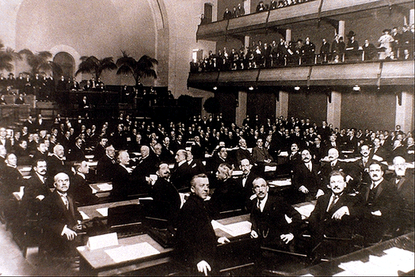
The Ineffectiveness of the League of Nations
No control of major conflicts.
No progress in disarmament.
No effective military force.

Slide 4
Japan’s War in China
Conquest of Chinese Manchuria 1931-1932
Full-scale invasion in 1937
The Rape of Nanjing
Ariel bombing of urban center
400,000 Chinese used for bayonet practice, massacred
7,000 women raped
1/3 of all homes destroyed
Japan signs Tripartite Pact with Germany, Italy (1940), Non-Aggression Pact with USSR (1941)

Slide 5
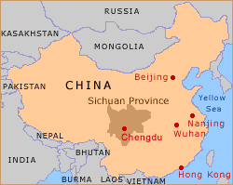
Japanese Aggression
When Japan invaded Manchuria, the League of Nations condemned the action, which led to Japan’s withdrawal from the group.
Their easy success in Manchuria and later in eastern China with the capture of Beijing, strengthened support for the militarists now in control.

Slide 6
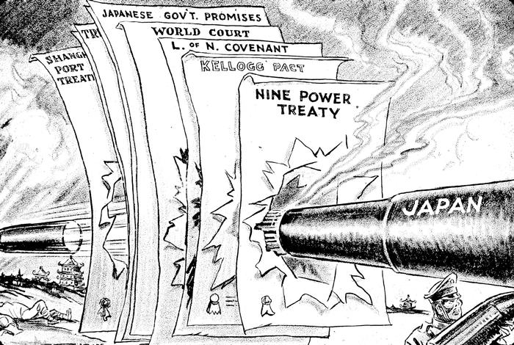
Japan Invades Manchuria, 1931

Slide 7
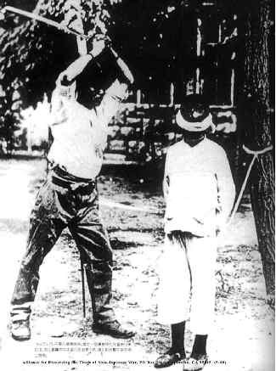
Nanking Massacre – Rape of Nanking
By 1939, Japan controlled a quarter of China including all of its seaports.

Slide 8
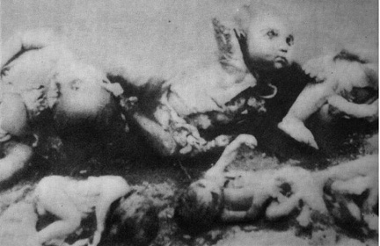
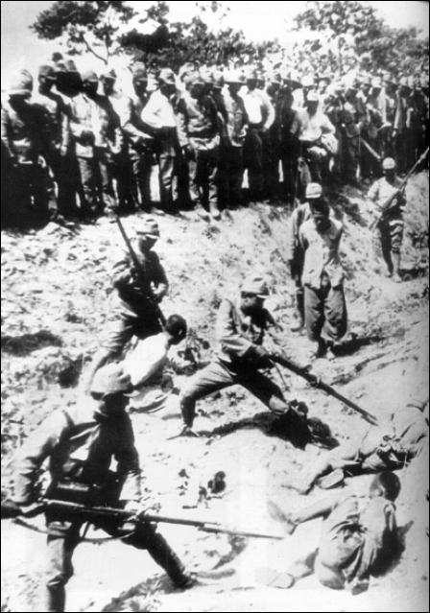
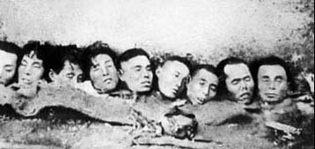
The Japanese Invasion of China, 1937

Slide 9
Chinese Resistance
Japanese aggression spurs “United Front” policy between Chinese Communists and Nationalists
Guerilla warfare ties down half of the Japanese army
Yet continued clashes between Communists and Nationalists
Communists gain popular support, upper hand by end of the war

Slide 10
Italian Aggression
Benito Mussolini invades Ethiopia with overpowering force
2,000 Italian troops killed, 275,000 Ethiopians killed
Also takes Libya, Albania

Slide 11
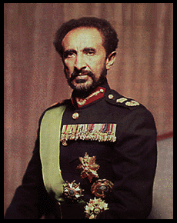
Ethiopia and King Haile Selassie
Ethiopia, one of the few independent nations in Africa was Mussolini’s first target.
In 1935, Italy invaded Ethiopia. The Ethiopian king, Haile Selassie I appealed to the League of Nations for help.
The Ethiopians valiantly tried to fight the Italians but their weapons were no match for the armored vehicles, planes and poison gas of the Italians.
In the spring of 1936, Mussolini announced that Ethiopia was part of the Italian Empire.

Slide 12
Germany
Adolf Hitler (1889-1945) withdraws from League of Nations
Remilitarizes Germany
Anschluss (“Union”) with Austria, 1938
Pressure on Sudetenland (Czechoslovakia)

Slide 13
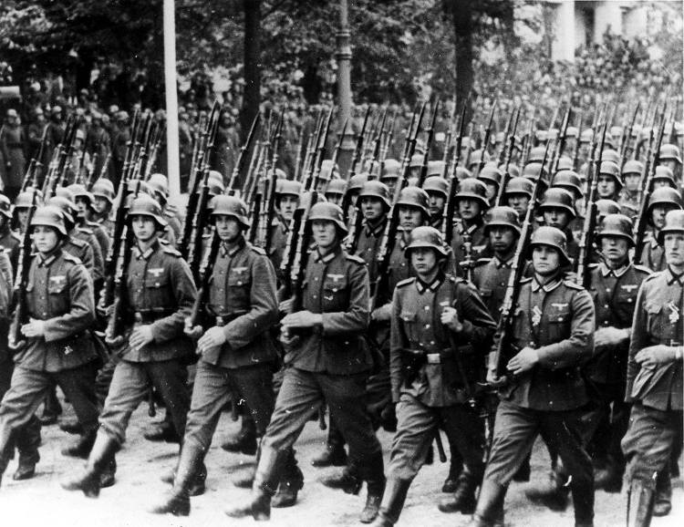
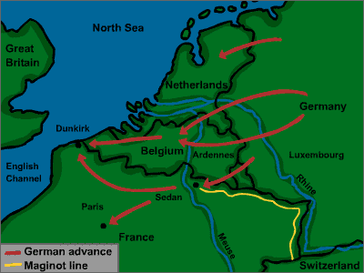
Germany Invades the Rhineland March 7, 1936

Slide 14
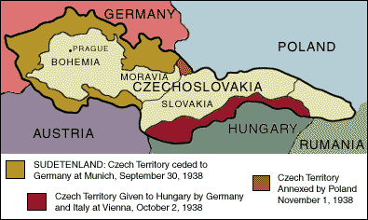
The “Problem” of the Sudetenland

Slide 15
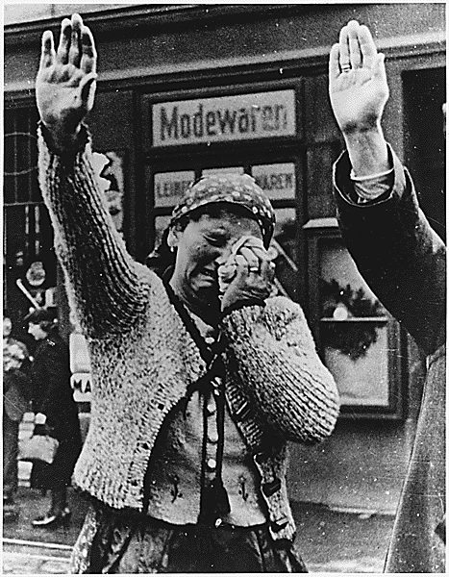
Along the Western rim of Czechoslovakia was an area known as the Sudetenland, made up of 3 million Germans (over 20% of Czechoslovakia’s population).
Hitler demanded that the Sudetenland be joined with Germany.
Within six months of the invasion, Czechoslovakia was temporarily erased from the map.
Woman in the Sudetenland weeping upon the annexation of the territory to Nazi Germany

Slide 16
Munich Conference (1938)
Italy, France, Great Britain, Germany meet
Allies follow policy of appeasement
Hitler promises to halt expansionist efforts
British Prime Minister Neville Chamberlain (1869-1940) promises “peace for our time”
Hitler signs secret Russian-German Treaty of Non-Aggression (Molotov-Ribbentrop Pact, August 1939)

Slide 17
Invasion of Poland and France
September 1, 1939
Blitzkrieg: “lightning war” strategy
Air forces soften up target, armored divisions rush in
German U-boats (submarines) patrol Atlantic, threaten British shipping

Slide 18
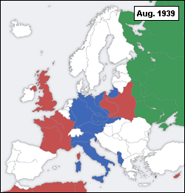
Red countries are Allied or Allied-controlled.
Blue denotes Axis or Axis controlled countries.
The Soviet Union is colored Green prior to joining the Allies in 1941.

Slide 19
Twice in less than 50 years, Germany had invaded France
After the war, France was determined to ensure that this never happened again.
France rebuilt its army and constructed a series of steel and concrete fortifications along its Western border, stretching nearly 200 miles long.
This was immensely expensive and further weakened the French economy.
The Maginot Line

Slide 20
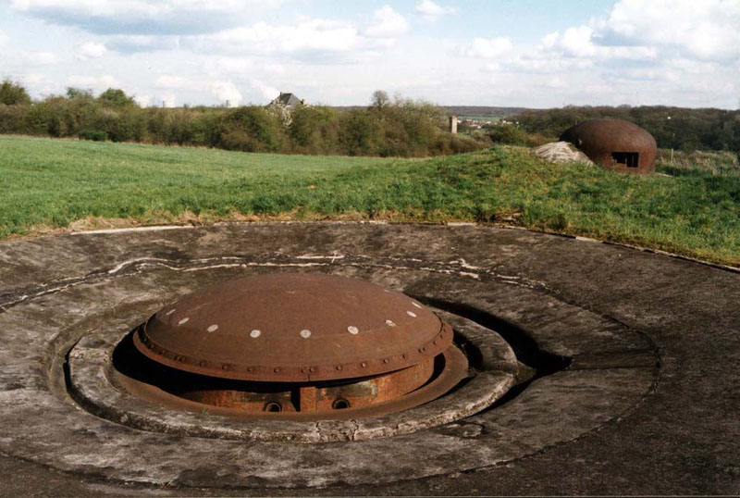
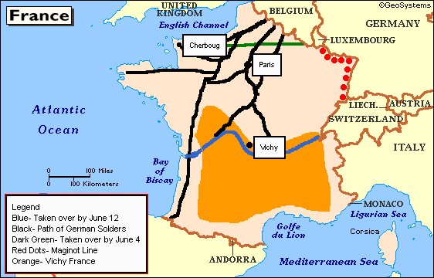
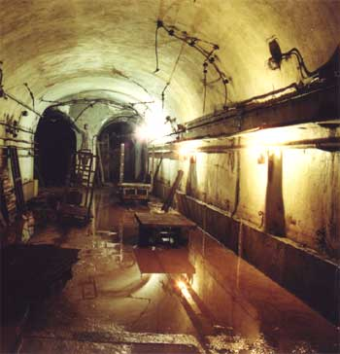
The Maginot Line

Slide 21
Anti-tank rails along a portion of the Maginot Line

Slide 22
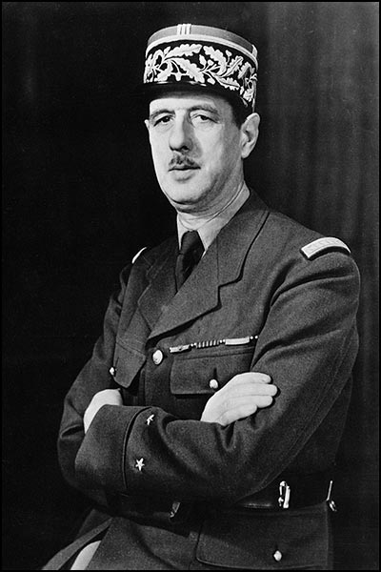
Charles de Gaulle
By June of 1940, the Germans entered Paris.
Rather than surrender, the French government resigned and France was divided between Northern France, from Paris up controlled by the Germans, and Vichy France set around the southern city of Vichy.
Charles de Gaulle set up the Free French government. They resisted against Germany, often using guerrilla tactics such as blowing up bridges, wrecking trains and cutting telephone and telegraph wires.

Slide 23
The Fall of France
1940: Germany occupies Denmark, Norway, Belgium, France
Hitler forces French to sign armistice agreement in same railroad car used for the armistice imposed on Germany in 1918

Slide 24
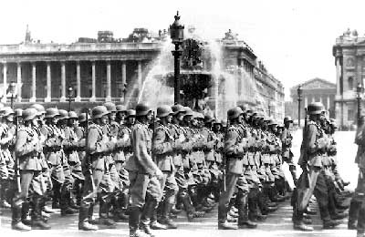
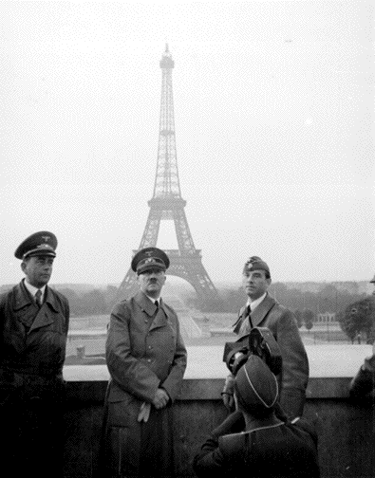
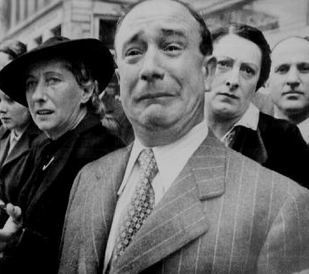
France Surrenders June, 1940

Slide 25
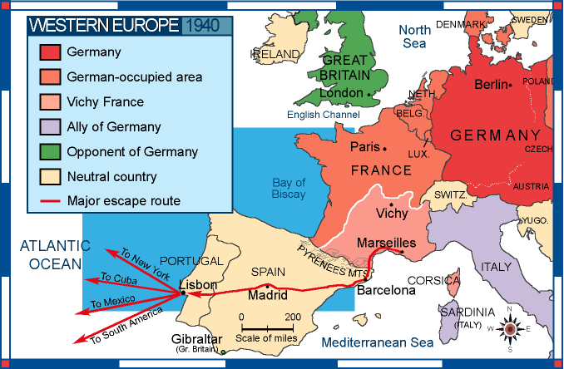

Slide 26
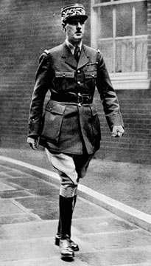
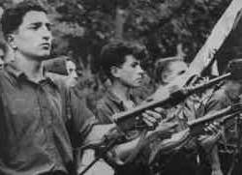
The French Resistance
The Free French
General Charles DeGaulle
The Maquis

Slide 27
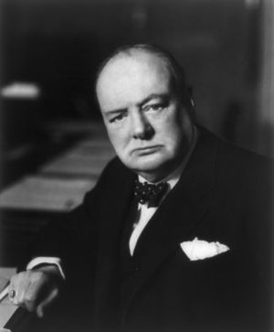
Winston Churchill
In May of 1940, Winston Churchill replaced Neville Chamberlain as the prime minister of Britain. Churchill had earned himself a reputation of speaking out against the policy of appeasement all throughout the 1930’s.
Hitler offered a peace negotiation which Churchill refused. In response, Hitler ordered his air force, the Luftwaffe to soften up Britain for invasion.

Slide 28
The Battle of Britain
Air war conducted by the German Luftwaffe
“The Blitz”
40,000 British civilians killed in urban bombing raids
Especially London
Royal Air Force prevents Germans from invading

Slide 29
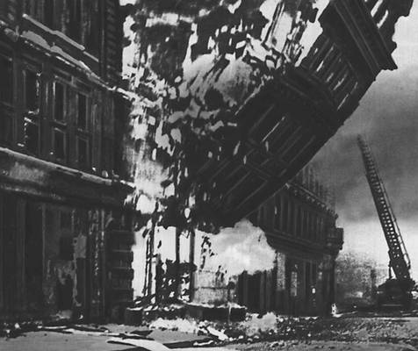
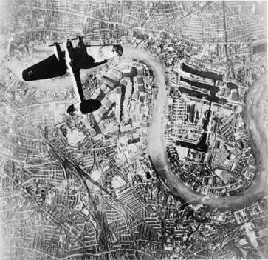
The Battle of Britain - 1940
The Battle of Britain is the attempt by the German Luftwaffe to gain air superiority over the Royal Air Force (RAF), before a planned sea and airborne invasion of Britain during World War II.

Slide 30
Operation Barbarossa
Lebensraum (“living space”)
June 22, 1941 Hitler double-crosses Stalin and invades USSR
Stalin caught off-guard, rapid advance
But severe winter, long supply lines weakened German efforts
Soviets regroup and attack Spring 1942
Turning point: Battle of Stalingrad (ends February 1943)

Slide 31
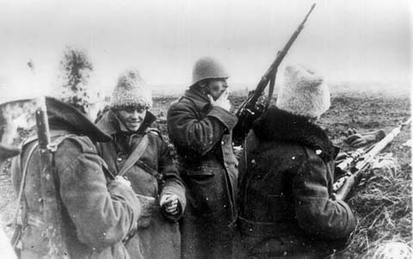
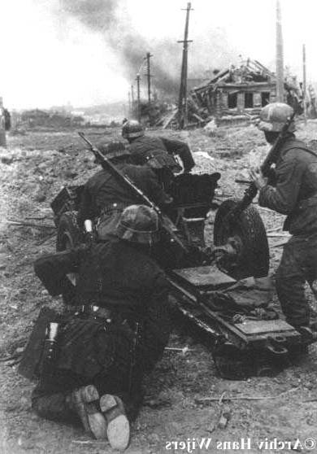
Battle of Stalingrad: Winter of 1942-1943
German Army | Russian Army
1,011,500 men | 1,000,500 men
10,290 artillery guns | 13,541 artillery guns
675 tanks | 894 tanks
1,216 planes | 1,115 planes

Slide 32
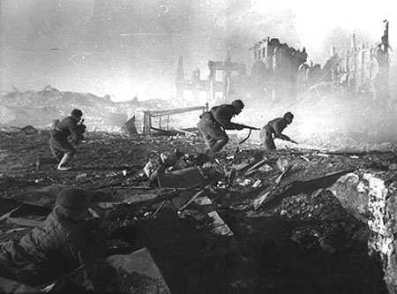
The Battle of Stalingrad
After failing to capture Moscow & Leningrad, Hitler tried one last attack on the city of Stalingrad in the south.
After six long months, again, the harsh winter not only drove the Germans out, but had the Soviets advancing towards Germany.
Assault at Stalingrad

Slide 33
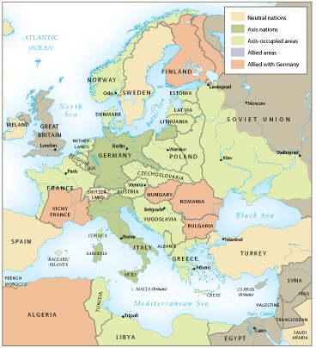
High tide of Axis expansion in Europe and North Africa, 1942-1943

Slide 34
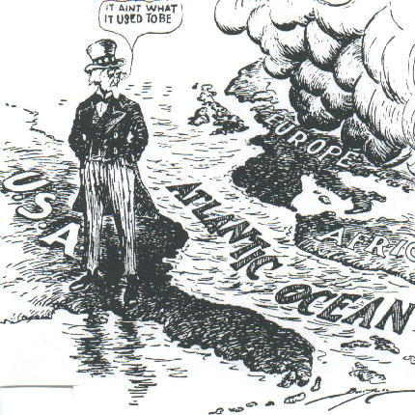
U. S. Neutrality Acts: 1934, 1935, 1937, 1939

Slide 35
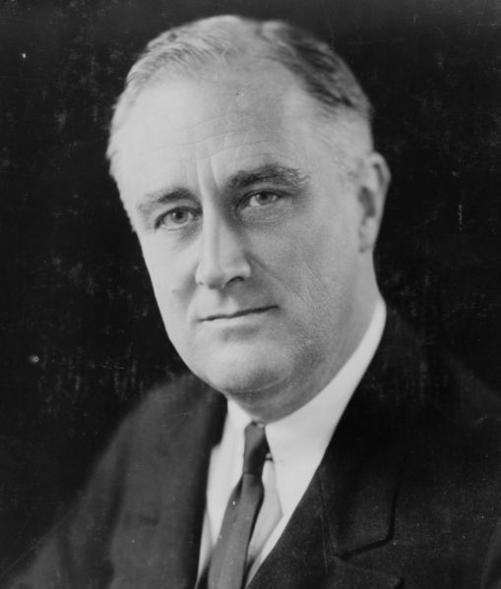
Franklin Delano Roosevelt
In September of 1940, United States President Franklin Delano Roosevelt Congress passed the first national draft law during peacetime.
In March of 1941, Churchill said “Give us the tools, and we will finish the job.”
That month Congress passed the Lend-Lease Act, authorizing the president to supply Great Britain with war materials on credit.

Slide 36
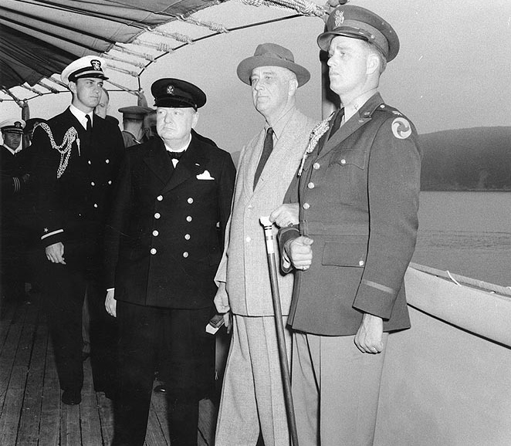
The Atlantic Charter
In August of 1941, the United States and Britain signed the Atlantic Charter that over its eight points, highlighted the terms and conditions for alliance in WWII.
Churchill meets Roosevelt aboard USS Augusta.

Slide 37
US Involvement in WWII before Pearl Harbor
US initiates “cash and carry” policy to supply Allies with arms
“lend-lease” program: US lends war goods to Allies, leases naval bases in return
US freezes Japanese assets in US
US places embargo on oil shipments to Japan
Japanese Defense Minister Tojo Hideki (1884-1948) plans for war with US

Slide 38
Pearl Harbor (December 7, 1941)
FDR: “A date which will live in infamy”
Destroyed US Navy in the Pacific
Hitler, Mussolini declare war on the US on December 11
US joins Great Britain and the USSR

Slide 39
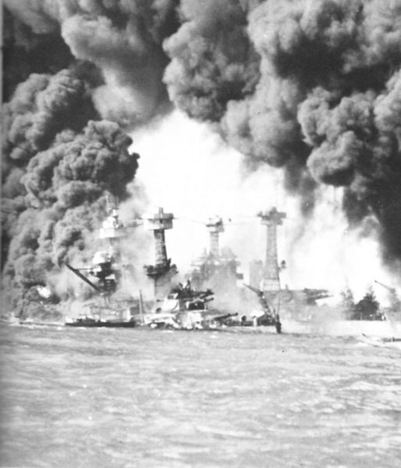
Pearl Harbor, Hawaii
Although the US had proclaimed neutrality, the Japanese saw the Atlantic Charter as a precursor to American involvement.
The US went further by banning the sale of all war materials to Japan, angering Japanese leaders.
Over 2400 American military were killed in the attack on December 7, 1941.
In response, US President FDR asked Congress to declare war on Japan.
American battleships West Virginia and Tennessee under attack at Pearl Harbor.

Slide 40
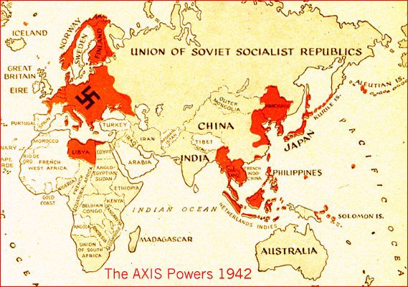
Axis Powers in 1942

Slide 41
Japanese Victories
Japan dominates south-east Asia, Pacific islands
Establishes “Greater East Asia Co-Prosperity Sphere”

Slide 42
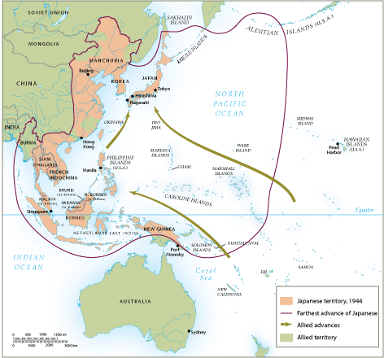
World War II in Asia and the Pacific

Slide 43
Defeat of the Axis Powers
Key factors: personnel reserves, industrial capacity
US joining the war turned the tide
Shipbuilding, automotive production especially important

Slide 44
Allied Victory in Europe
Red Army (USSR) gains offensive after Stalingrad (February 1943)
British, US forces attack in North Africa, Italy
D-Day: June 6, 1944, British and US forces land in France
US, Britain bomb German cities
Dresden, February 1945: 135,000 Germans killed in shelters
30 April 1945 Hitler commits suicide, 8 May Germany surrenders

Slide 45
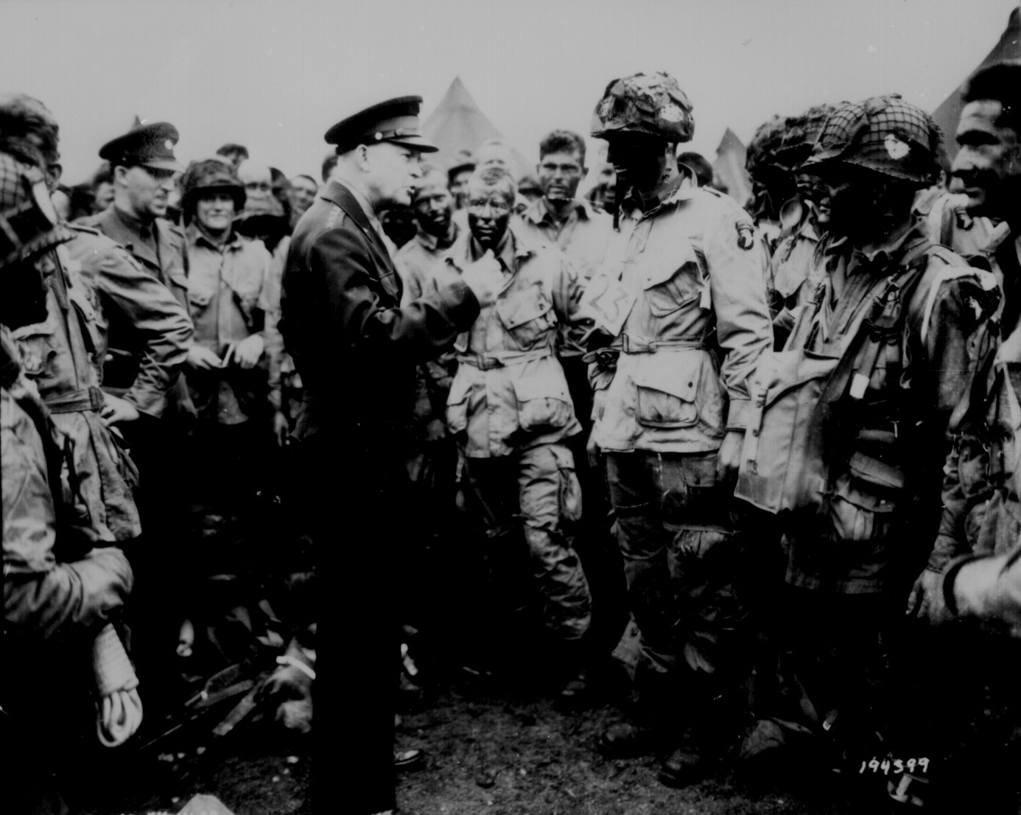
Gen. Eisenhower Gives the Orders for D-Day [“Operation Overlord”]

Slide 46
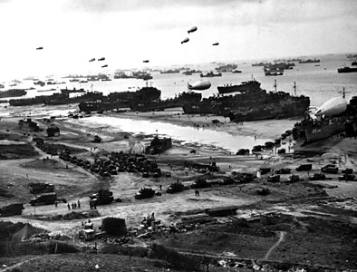
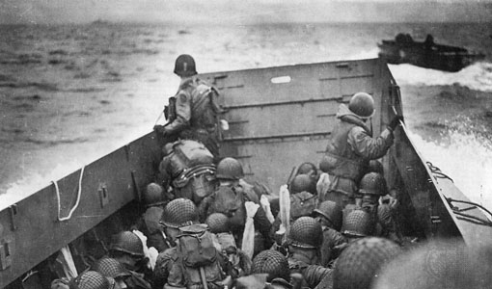
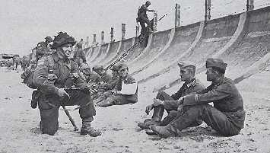
Normandy Landing (June 6, 1944)
German Prisoners
Higgins Landing Crafts

Slide 47
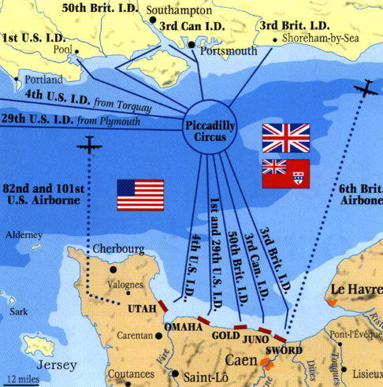
D-Day (June 6, 1944)

Slide 48
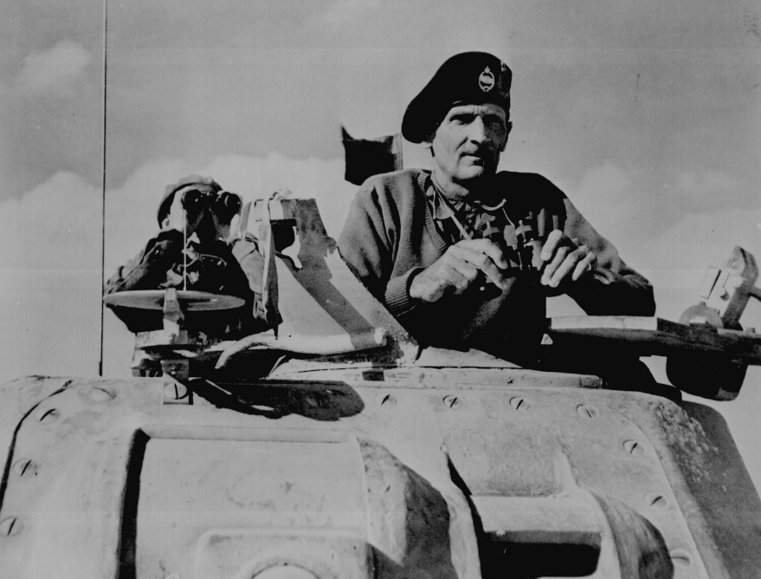
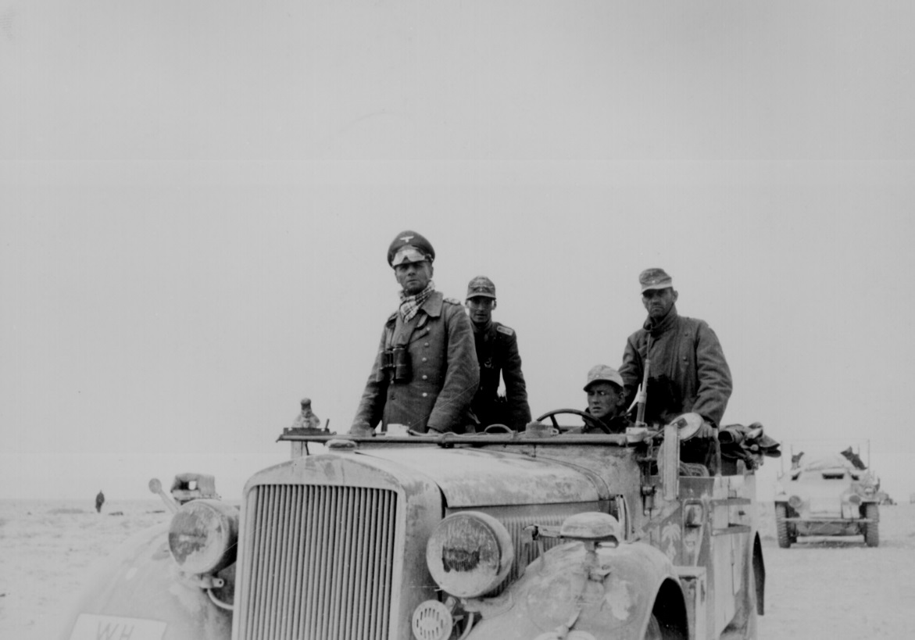
The North Africa Campaign: The Battle of El Alamein, 1942
Gen. Ernst Rommel, The “Desert Fox”
Gen. Bernard Law Montgomery (“Monty”)

Slide 49
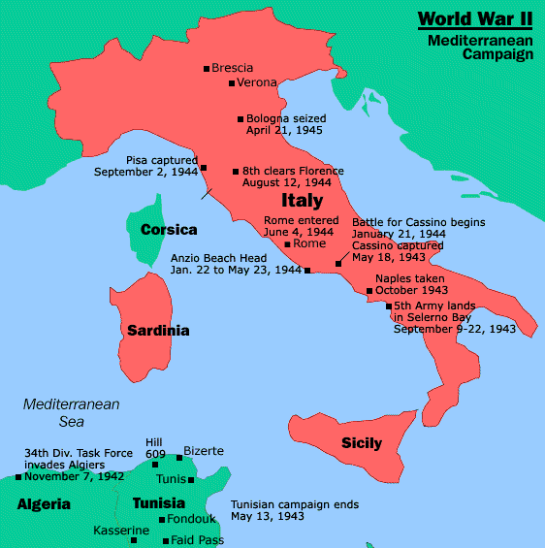
The Italian Campaign [“Operation Torch”] : Europe’s “Soft Underbelly”
Allies plan assault on weakest Axis area - North Africa - Nov. 1942-May 1943
George S. Patton leads American troops
Germans trapped in Tunisia - surrender over 275,000 troops.

Slide 50
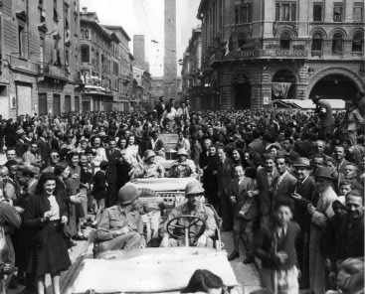
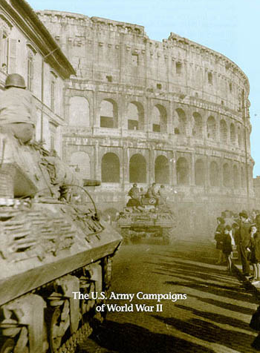
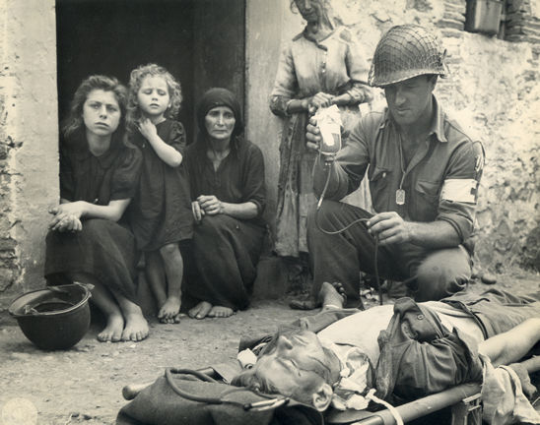
The Allies Liberate Rome: June 5, 1944

Slide 51
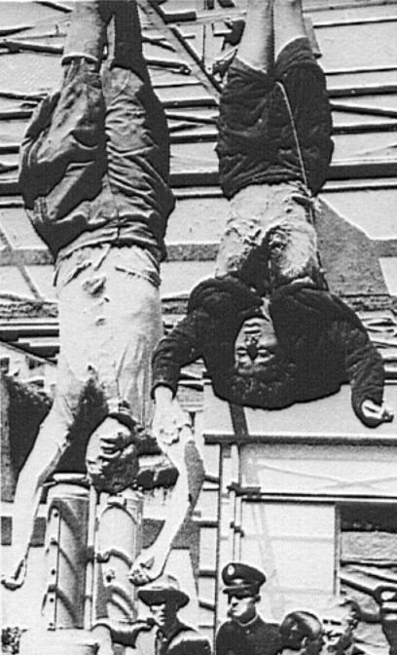
Mussolini & His Mistress, Claretta Petacci Are Hung in Milan, 1945

Slide 52
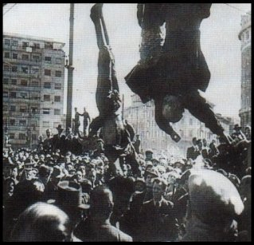
Italy Surrenders
Allied success at Battle of El Alamein allowed Britain and the United States to allowed the British/American force to land in what Churchill called the “soft underbelly of the Axis.”
Upon the Allied invasion, Mussolini was forced to resign. His successor’s first act was to dissolve the Fascist Party.
Clara Petacci (left) and Benito Mussolini (right) hung by their feet after death.

Slide 53
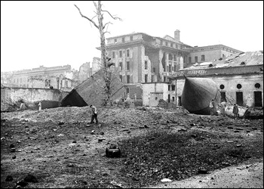
Hitler Commits Suicide April 30, 1945
Cyanide & Pistols
The Führer’s Bunker
Mr. & Mrs. Hitler

Slide 54
Turning the Tide in the Pacific
US code breaking operation Magic discovers Japanese plans
Battle of Midway (June 4, 1942)
US takes the offensive, engages in island-hopping strategy
Iwo Jima and Okinawa
Japanese kamikaze suicide bombers
Savage two-month battle for Okinawa

Slide 55
Bataan Death March
In 1942, Japanese soldiers forced 78,000 prisoners over 55 miles up the Bataan peninsula, killing more than 600 Americans and 10,000 Filipinos who were beaten, stabbed and shot.
This incident became known as the Bataan Death March.
In October of 1944, American army General Douglas MacArthur began the defeat of the Japanese in the Philippines.
American propaganda poster in response to the news in the Philippines.

Slide 56
Battle of Midway
In the Pacific, America made great gains against Japan at the Battle of Midway, which was fought when the Japanese tried to capture Midway Island, north of Hawaii.
This success in 1942, led the US to clear the Japanese from the Marshall Islands, New Guinea, and the Marianas.
In October of 1944, American army General Douglas MacArthur began the defeat of the Japanese in the Philippines.
The Japanese cruiser Mikuma shortly before sinking.

Slide 57
Japanese Surrender
US firebombs Tokyo, March 1945
100,000 killed
25% of buildings destroyed
Atomic bombs dropped on Hiroshima and Nagasaki, August 1945
Emperor Hirohito (1901-1989) surrenders unconditionally September 2, 1945

Slide 58
The Manhattan Project: Los Alamos, NM
I am become death, the shatterer of worlds!
Major General Lesley R. Groves
Dr. Robert Oppenheimer

Slide 59
Tinian Island, 1945
Little Boy Fat Man
Enola Gay Crew

Slide 60
Hiroshima – August 6, 1945
70,000 killed immediately.
48,000 buildings. destroyed.
100,000s died of radiation poisoning & cancer later.

Slide 61
Nagasaki – August 9, 1945
40,000 killed immediately.
60,000 injured.
100,000s died of radiation poisoning & cancer later.

Slide 62
Varieties of Wartime Occupation
Independent States with enforced alliances
Thailand, Denmark
Puppet States
Manchukuo, Vichy France
Military Administration
Indochina, Poland

Slide 63
Collaboration
For some, opportunity for social mobility under conquerors
Sometimes considered a lesser evil than military administration

Slide 64
Resistance
Military forms of resistance
Intelligence gathering
Protecting refugees
Symbolic gestures
German, Japanese policies of collective punishment

Slide 65
Nazi Genocide and the Jews
Jews primary target of Nazi genocidal efforts
Other groups also slated for destruction: Roma (Gypsies), Homosexuals, Jehovah’s Witnesses
Nazis initially encouraged Jewish emigration
Few countries willing to accept Jewish refugees
Aborted plans to deport Jews to Madagascar, reservation in Poland

Slide 66
The Final Solution
Einsatzgruppen (mobile killing squads) follow German army into USSR with Operation Barbarossa
Round up of Jews and others, machine-gun executions of 1.4 million
Later in 1941 decided on “Final Solution:” deportation of all European Jews to Death Camps
Plans solidified at Wannsee Conference, January 1942

Slide 67
Concentration Camps

Slide 68
Horrors of the Holocaust Exposed
Mass Graves at Bergen-Belsen

Slide 69
The Holocaust
Jews deported from ghettos all over Europe in cattle cars, spring 1942
Destination: six specially designed Death Camps in Eastern Europe
Technologically advanced, assembly-line style of murder through poison gas (Zyklon B)
Corpses destroyed in crematoria
Estimated number of Jews killed: 5.7 million

Slide 72
Jewish Resistance
German policy of collective punishment, generations of life as a minority hamper Jewish resistance efforts
Yet ghetto uprisings, armed conflict nevertheless
Warsaw Ghetto Uprising, spring 1943
Jews in partisan guerilla units

Slide 73
Women and the War
WAVES (Women Appointed for Volunteer Emergency Service)
US, Great Britain bar women from serving in combat units
Soviet, Chinese forces include women fighters
Women very active in resistance movements

Slide 74
Women’s Roles
Women occupy jobs of men away at war
Also take on “head of household” duties
Temporary: men returning from war displace women
Yet lasting impact on women’s movement

Slide 75
Origins of the Cold War
US, USSR, Great Britain unnatural allies during World War II
Tensions submerged until close of war
Yalta and Potsdam Conferences (1945)
Stalin, Churchill, Roosevelt
Decided on USSR declaration of war vs. Japan, setting up of International Military Tribunal
Free elections for Eastern Europe
Stalin arranges pro-communist governments in Eastern European countries
1946: “Iron Curtain” descends

Slide 76
The Yalta Conference
In February of 1945, Roosevelt, Churchill and Stalin met at a Soviet resort called Yalta, which ended in an agreement for the Soviets to enter the war with the allies against Japan.
The "Big Three" at the Yalta Conference, Winston Churchill, Franklin D. Roosevelt and Joseph Stalin.

Slide 77
Modern Warfare
of WWII
Machine
Guns
Improved
Submarines
Sonar to Detect
Submarines
Improved
Airplanes
Aircraft
Carriers
Radar to
Detect Airplanes
Aircraft Carriers
Deadlier Bombs
Fast-Moving
Armored Tanks
Walkie-talkies

Slide 78
The Creation of the U. N.

Slide 79
The Nuremberg War Trials: Crimes Against Humanity

