Slide 1
Petrarch
Father of Humanism

Slide 2
Italian poet, 1304-1374

Slide 3
Early Interest in Literature
Petrarch studied law.
However, his passion was for literature, particularly that of ancient Greece and Rome.
Petrarch became a cleric, which supported him as he pursued his interest in ancient literature.
Traveling as a diplomatic envoy for the Church, he was also able to search for forgotten classical texts.
Throughout his lifetime, Petrarch amassed an impressive collection of such texts, which he later bequeathed to Venice in exchange for a house, refuge from the plague.

Slide 4
Humanism
As Petrarch learned more about the classical period, he began to venerate that era and rail against the limitations of his own time.
Though he felt that he lived "amid varied and confusing storms," Petrarch believed that humanity could once more reach the heights of past accomplishments.
The doctrine he espoused became known as Humanism, and formed a bridge from the Middle Ages to the Renaissance.

Slide 5
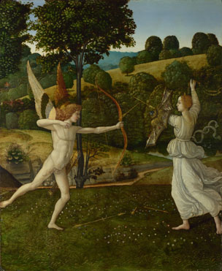
In your literature textbook…
Read about Petrarch on p. 728.
Read all of p. 729.
Read all of p. 730.

Slide 6
Petrarchan Sonnet
14 lines
Octave (first 8 lines) rhymes abba abba
Sestet (last 6 lines) rhymes cdecde OR cdcdcd OR cdedce

Slide 7
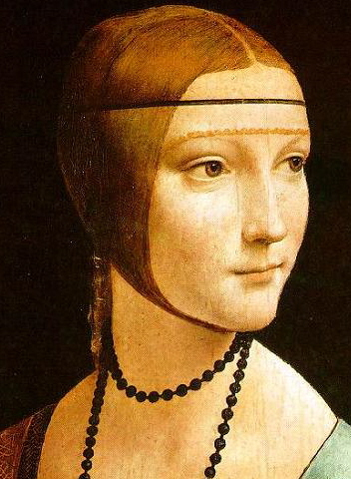
In your literature textbook…
Read Laura on p. 731.
Determine which lines form the octave.
Check the rhyme scheme.
Determine which lines form the sestet.
Which rhyme scheme is used?

Slide 8
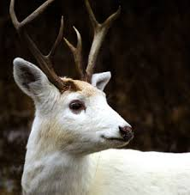
In your literature textbook…
Read The White Doe on p. 732.
Determine which lines form the octave. Check the rhyme scheme.
Determine which lines form the sestet. Which rhyme scheme is used?
Remember Allegory (think Inferno). What do each of the following symbolize? the doe, the sign worn by the doe, the stream

Slide 9
In your literature textbook…
Read Spring on p. 733.
Determine which lines form the octave. Check the rhyme scheme.
Determine which lines form the sestet. Which rhyme scheme is used?
How does this poem show Petrarch’s interest in the Classical era and Humanism?

Slide 10
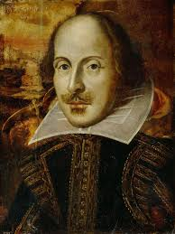
Shakespearean Sonnet
14 lines
Three quatrains (first 12 lines) rhyme abab cdcd efef
Couplet (last 2 lines) rhymes gg

Slide 11
In your literature textbook…
Read about Shakespearean Sonnets on p. 740.
Read Sonnet 29 on p. 740.
Read Sonnet 116 p. 741.
How do Shakespearean sonnets compare to Petrarchan sonnets?

