Slide 1
Niccolo Machiavelli
The Prince

Slide 2
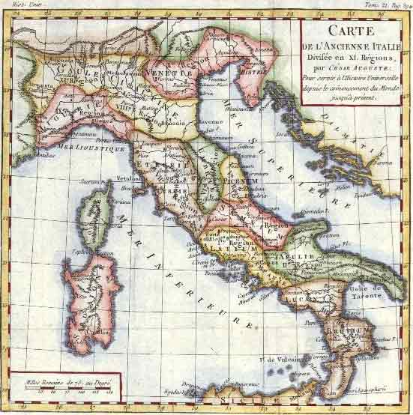
13th Century Florence
Italy divided into city states, not united nation
Unlike feudal Europe, northern Italy dominated by cities which became major trading and economic centers
Battle between states for power, constant changing of gov’ts, leaders

Slide 3
Machiavelli (1469-1527)
Machiavelli raised in Florence
Born at a time when there was continual struggle for power between city states, church
At age 29, elected to office in Florence
Part of a diplomatic council in charge of negotiation and military affairs
Between 1503-1506, in charge of Florence’s militia
In August, 1512 the Medici take control of Florence
Machiavelli arrested and tortured, but is eventually allowed to go free and into exile where he writes The Prince.

Slide 4
The Prince
Written in 1513
Machiavelli’s most famous work
Addresses the concept of the “new prince,” rather than the hereditary prince, who must stabilize his power as well as building political structure
Seen as the break between political idealism (Plato, Aristotle) and political realism

Slide 5
Understanding the text
Beginnings of empiricism and realism
Challenged the Christian value of Providence
Individual determines his own fate
Natural to be ambitious and seek glory, encourages risk taking, new systems
Leaders should not be religious but encourage his people to be religious
Helps maintain order and control
Good ends justify bad means
Basis of capitalism

Slide 6
Royalty or Republic?
The Prince gives advice on achieving and maintaining political power
Text alludes to monarch, but other works indicate Machiavelli saw value in a republic
In 18th century, The Prince was viewed by critics as a satirical piece of writing
Current modern critics see The Prince as having some clear elements of irony

Slide 7
Lasting legacy
Machiavellian: a term used to describe those who manipulate others for their own political advantage
Text had significant influence on a wide range of leaders, philosophers
John Adams extensively quotes Machiavelli in A Defense of the Constitution of the United States of America
Bacon, Hume, Hobbes, Locke, Rousseau, Descartes

Slide 8
DEDICATION: To the Magnificent Lorenzo Di Piero De' Medici:
Those who strive to obtain the good graces of a prince are accustomed to come before him with such things as they hold most precious, or in which they see him take most delight; whence one often sees horses, arms, cloth of gold, precious stones, and similar ornaments presented to princes, worthy of their greatness.
Desiring therefore to present myself to your Magnificence with some testimony of my devotion towards you, I have not found among my possessions anything which I hold more dear than, or value so much as, the knowledge of the actions of great men, acquired by my long experience in contemporary affairs, and a continual study of antiquity; which, having reflected upon it with great and prolonged diligence, I now send, digested into a little volume, to your Magnificence.

Slide 9
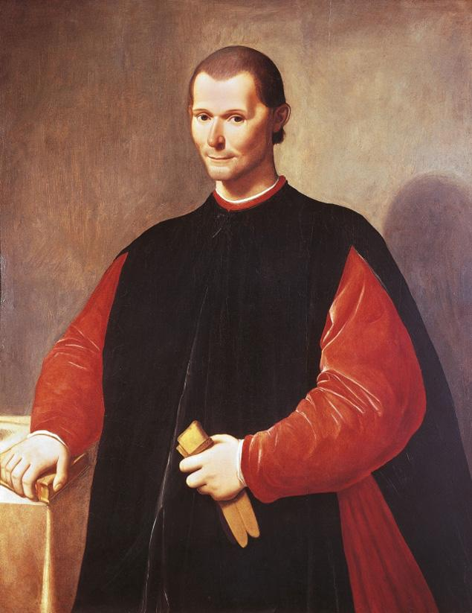
“…it may be said of men in general that they are ungrateful, voluble dissemblers, anxious to avoid danger….
As long as you benefit them, they are entirely yours; they offer you their blood, their goods, their life and their children.
But a prince who relies solely on their words, without making other preparations is ruined.”

Slide 10
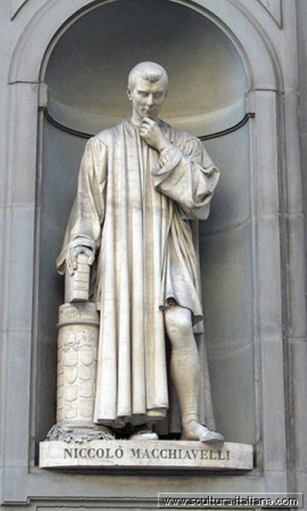
“By no means can a prudent ruler keep his word….If all men were good it would be all right to keep promises, but because they are bad and do not keep promises to you, you likewise do not have to keep promises to them.”

Slide 11
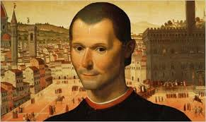
“It is better to be feared than loved…When it is impossible to be both feared and loved, choose to be feared. Men’s affections are very changeable, but fear and terror keeps people loyal and subservient.”

Slide 12
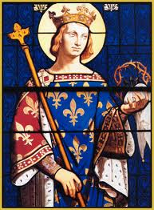
“A prince must take great care that nothing goes out of his mouth which is not full of seeming merciful, faithful, humane, sincere and religious….Everybody sees what you appear to be, few really know who you are...”

Slide 13
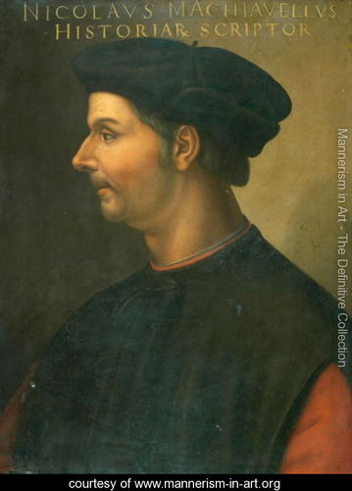
“You must know then, that there are two methods of fighting, the one by law, the other by force.
The first method is that of men, the second of beasts; but as the first method is often insufficient, one must have recourse to the second.”

Slide 14
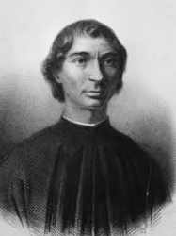
“…every prince must desire to be considered merciful and not cruel. He must however, take care not to misuse this mercifulness. Cesare Borgia was considered cruel, but his cruelty brought order to Romagna, united it and reduced it to peace.”

Slide 15
“Let a prince therefore aim at conquering and maintaining the state, and the means will always be judged honorably and praised by everyone in so far as the end justifies the means.”

