Slide 1
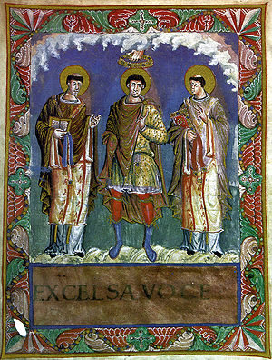
Life & Literature in
The Medieval Period

Slide 2
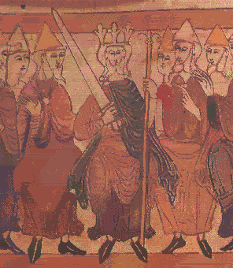
What was it like to live in the Middle Ages?

Slide 3
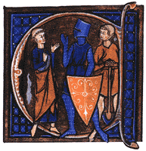
The 3 Estates in the Middle Ages
The idea of estates, or orders, was encouraged during the Middle Ages:
  Clergy
    Latin chiefly spoken, those who pray, purpose was to save everyone’s soul
  Nobles
    French chiefly spoken, those who fight, purpose was to protect—allow for all to work in peace—and provide justice
  Commoners
    English spoken, those who work, purpose was to feed and clothe all above them

Slide 4
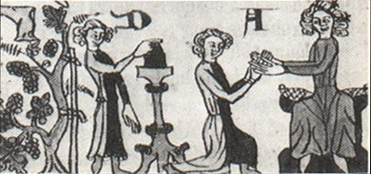
feudalism
The economic system of much of the Middle Ages (800-1100) was called feudalism.
Commoners (peasants) lived on a feudal manor. The lord of the manor gave his vassals (the peasants) land to farm.
In return, the vassals received protection from roving bandits. Yet they were taxed and had to surrender a portion of their crops to the lord.
  it was better to be a lord than a vassal!
Feudalism is important as it created ties of obedience and fostered a sense of loyalty between the vassals and their lord.
A tenant (vassal) renews his oath of fealty to his lord

Slide 5
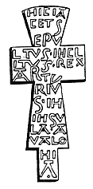
The Church
Provided guidance through well known precepts..
  Seven Deadly Sins
    Pride
    Greed
    Wrath
    Envy
    Gluttony
    Sloth
    Lust

Slide 6
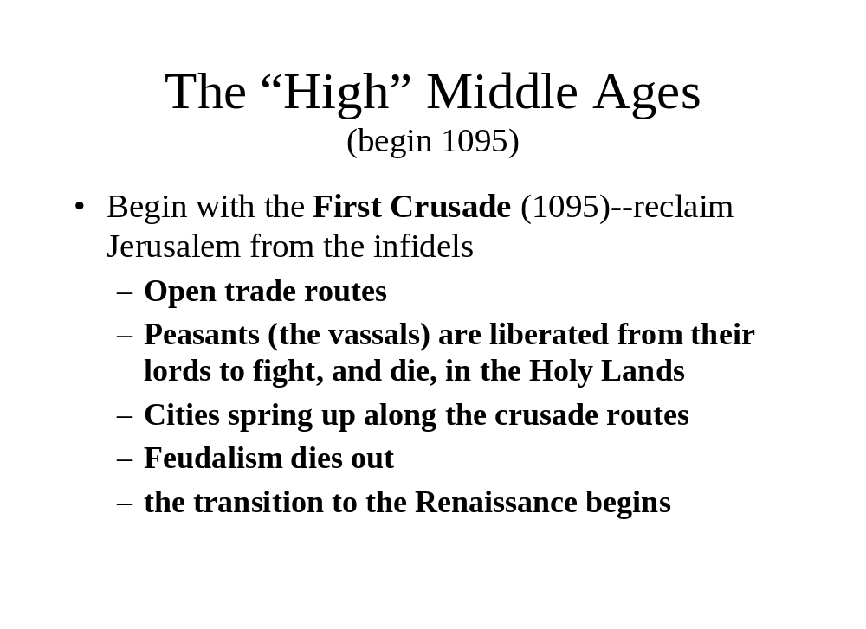

Slide 7
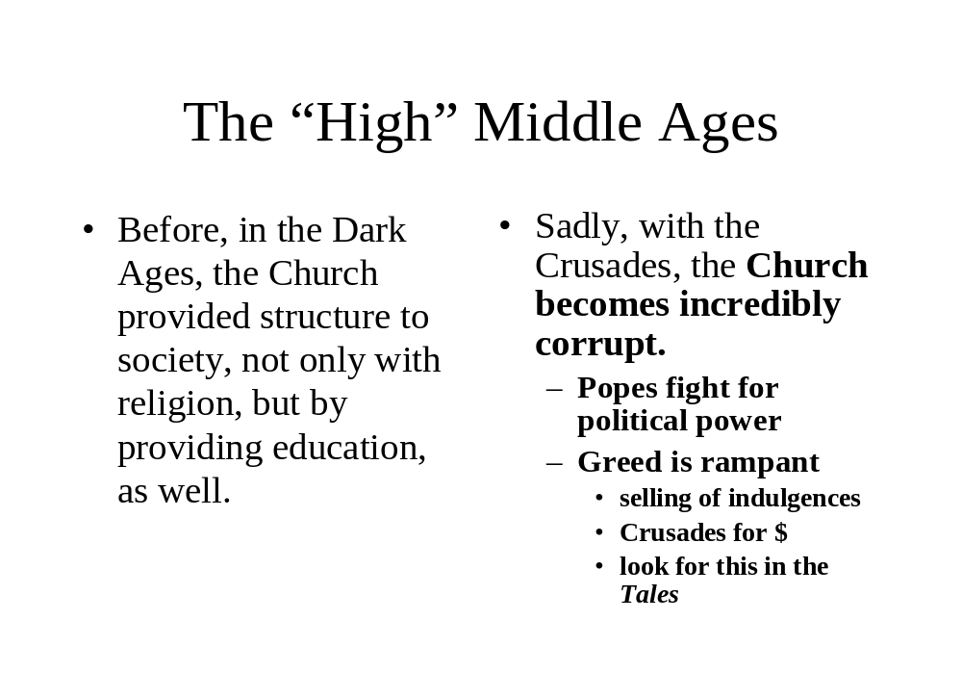

Slide 8
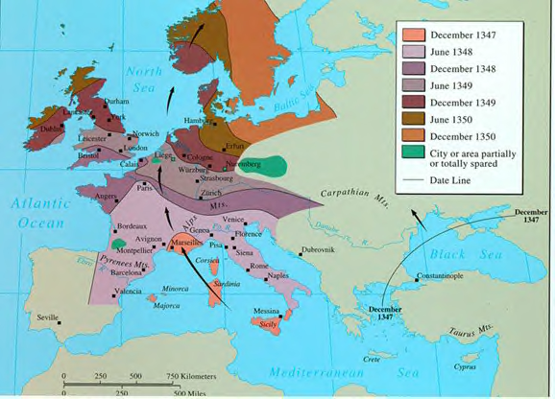
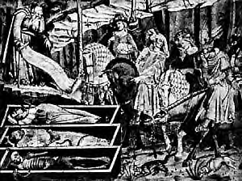
With the Crusades comes
The Black Death
spreads along trade routes
kills much of the population
the plague outbreaks occur through the Middle Ages and into the Renaissance
Paradoxically, the Plague provides for continued growth in cities
  Afterwards, hundreds of new jobs available
  Many debts “died off” with creditors
also contributed to society’s culture

Slide 9
Enough already!
I thought this was an English class!

Slide 10
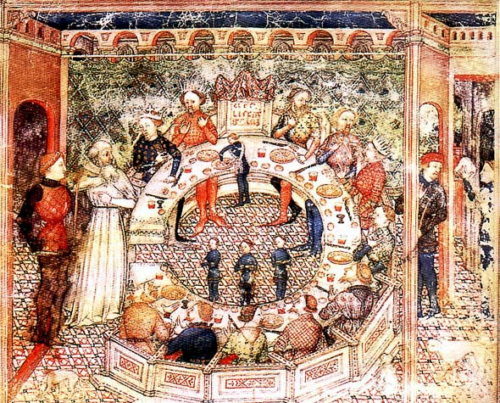
Literature During the Medieval Period

Slide 11
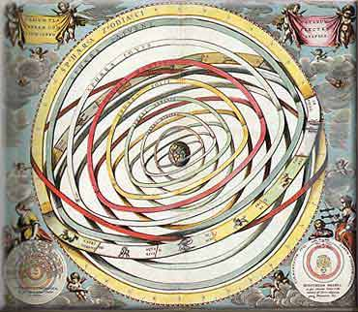
Languages
Latin was the language of the Roman Catholic Church, which dominated Europe
The Church was the only source of education
Thus, Latin was a common language for Medieval writings. [The commoners couldn’t read anyway – they’d have heard the stories passed down orally.]

Slide 12
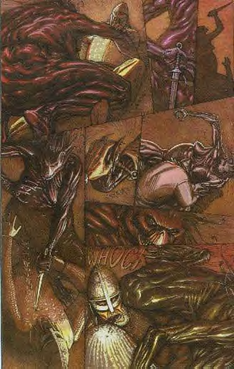
A great amount of medieval literature is anonymous. Medieval authors often tended to re-tell and embellish stories they heard or read rather than invent new stories.

Slide 13
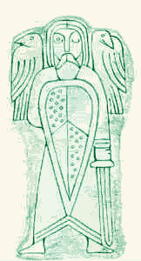
Writings
Catholic clerics were the intellectual center of society in the Middle Ages, and it is their literature that was produced in the greatest quantity.

Slide 14
Characteristics of Medieval Literature
Romance
  A narrative in prose or verse that tells of the high adventures and heroic exploits of chivalric heroes
    Tells of exploits of knights
    often a supernatural element involved
Christian message
  concern with salvation and the world to come
  no interest in social change, only spiritual change
    This was true until the late 14th century
    Geffrey Chaucer and Dante Alighieri signal new thinking, try up-ending social order

Slide 15
Characteristics of Medieval Literature
Heroism
  from both Germanic and Christian traditions, sometimes mingled
    Beowulf
    Sir Gawain and the Green Knight
    Song of Roland
    The Nieblungenlied
Presentations of idealized behavior
  literature as moral lesson
    loyalty to king
    chivalry
use of kennings
  A figurative, usually compound expression used in place of a name or noun. Example, storm of swords is a kenning for battle.

Slide 16
Characteristics of Medieval Literature – Use of Allegory
An allegory is a figurative mode of representation conveying a meaning other than the literal.
Much of medieval literature relied on allegory to convey the morals the author had in mind while writing--representations of abstract qualities, events, and institutions are thick in much of the literature of this time.
Dante’s Inferno is a classic example of medieval allegory!

Slide 17
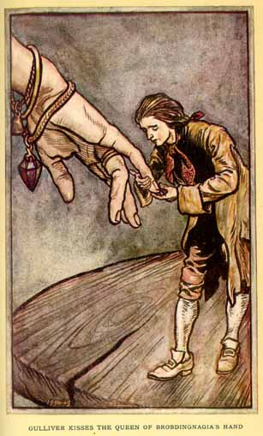
Conventions of Medieval Romance
We’ll focus first on reading two Medieval Romance texts. The influence of Medieval romance, with its roots in epic poetry, winds through English literature: through the Renaissance, the Enlightenment, in the literary Romantic movement, and, of course, in modern takes on romance from T.H. White, and of course, Monty Python!*
Notes:
Renaissance: Edmund Spenser’s Faerie Queene, Shakespeare’s Romantic plays.
In the Enlightenment, in mock epics such as Pope’s the Rape of the Lock and in satires as Swift’s Gulliver’s Travels
Poets of the Romantic and Transcendental movements absorb many of the conventions of romance, as well as extensively use allusions to these tales.
Marion Zimmer Bradley’s The Mists of Avalon, also, in modern times

Slide 18
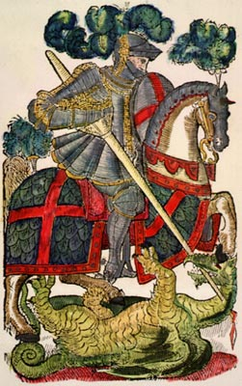
Conventions of Medieval Romance
Medieval Romances:
Often have unprovoked and violent fighting!
Are set in a mystical place and time (the Dark Ages)
Present supernatural elements, and magical powers from the pagan world
Have a hero who is on a noble adventure or quest
Have a loose, episode-like structure
Include elements of courtly love
Embody ideals of chivalry
Time frame of a year and a day

Slide 19
Chivalric Code and Introduction to Courtly Love
Chivalry is from the French word, chevalier, meaning horseman, or knight. *
The Code of Chivalry influenced the formation of religious military orders during the period of the Crusades. The now famous Knights Templar and the Hospitalers are among the most noted knights of this period.
During the later middle ages, chivalry had become largely a system of manners for the knights and a source of entertainment during tournaments – which themselves gradually became less threatening to the participants than live battle.
Notes:
This was the precursor of the notion “a gentleman and a soldier,” or, simply a “gentleman.” Mostly nobles were granted knighthood, and although today anyone can be knighted, the “service to the king and country” can take on many shapes and forms….

Slide 20
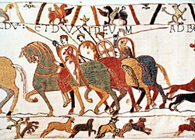
Chivalric Code and Introduction to Courtly Love
The chivalric code combined Christian virtues with military virtues:
Temperance, Fortitude, Prudence and Justice
Faith, Hope, Charity
Valor and strength in battle
Loyalty to God and King
Courtesy towards enemies
Generosity towards the sick, women, widows and the oppressed
Courtly Love*
Notes:
See separate power point program.

Slide 21
The Ideal of Courtly Love
This relationship was modeled on the feudal relationship between a knight and his liege lord.
The knight serves his courtly lady with the same obedience and loyalty which he owes to his liege lord.
She is in complete control; he owes her obedience and submission

Slide 22
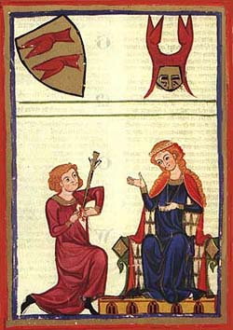
The knight's love for the lady inspires him to do great deeds, in order to be worthy of her love or to win her favor.

Slide 23
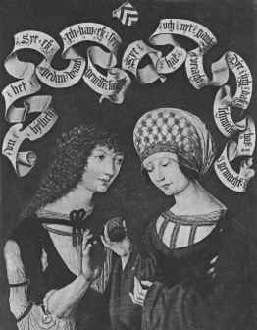
“Courtly love" was not between husband and wife because it was an idealized sort of relationship that could not exist within the context of "real life" medieval marriages.
In the middle ages, marriages amongst the nobility were typically based on practical and dynastic concerns rather than on love.

Slide 24
“Courtly love" provided a model of behavior for a class of unmarried young men who might otherwise have threatened social stability.
Knights were typically younger brothers without land of their own (hence unable to support a wife).
They became members of the household of the feudal lords whom they served.

Slide 25
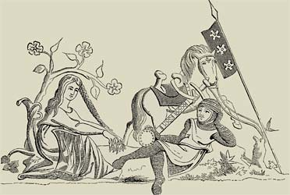
The lady is typically older, married, and of higher social status than the knight because she was modeled on the wife of the feudal lord, who might naturally become the focus of the young, unmarried knights' desire.

Slide 26
The literary model of courtly love may have been invented to provide young men with a model for appropriate behavior.
It taught bored young knights to control their baser desires and to channel their energy into socially useful behavior (love service rather than wandering around the countryside, stealing or raping women).

Slide 27
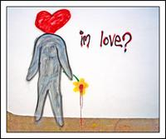
The "symptoms" of love were described as as if it were a sickness.
The "lovesick" knight’s typical symptoms: sighing, turning pale, turning red, fever, inability to sleep, eat or drink.

Slide 28
The Quest
In addition to the theme of Courtly Love, the Quest was highly important to medieval romance:
the code of conduct observed by a knight errant who is wandering in search of deeds of chivalry. This knight is bound by a code of behavior - a set of conventional principles and expectations

Slide 29
The Quest, cont’d
A quest is a hero’s journey towards a goal. The objects of quests require great exertion on the part of the hero, and the overcoming of many obstacles (think Hero’s Journey archetype!).
The heroes must obtain something, or someone, by the quest and with this object return home.

Slide 30
The Quest, cont’d
Usually, an inner and outer problem for the character is set.
The hero is introduced; audience identifies with them
The hero lacks something, has a tragic flaw, or a deep wound
The call often produces disorientation and discomfort for the hero
The call is often in the form of a dire warning

Slide 31
Excuses are used to avoid the call
This hesitation illustrates the formidability of the challenge ahead
Resistance creates change and strength, allowing the hero to grow
A physical or metaphorical crossing is made
The crossing is an irrevocable leap of faith, from which there’s no turning back

Slide 32
The hero faces his greatest fear
The hero “dies,” so he can be reborn
The hero gains new perception
This new perception may create a moment of clarity
The moment may be of great self-realization for the hero
It may also be an epiphany for the hero’s companions

Slide 33
The Medieval Hero
Is often of divine descent endowed with great strength and ability" or "a man admired for his achievements and noble qualities"
(Sound familiar?!?!?)

Slide 34
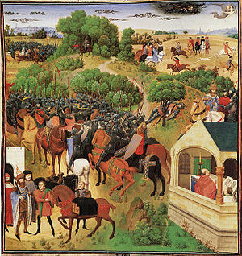
The Song of Roland
(La Chanson de Roland)
The oldest surviving French medieval romance epic, The Song of Roland was written down between 1140 and 1170 AD, but tells of actual events that occurred on August 15, 778 AD.

Slide 35
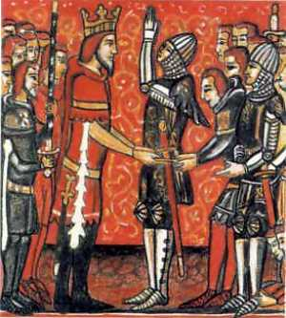
The Song of Roland
(La Chanson de Roland)
The story told in the poem is based on a historical incident, the Battle of Roncevaux Pass on 15 August 778, in which the rear guard of Charlemagne's withdrawing Franks (French forces), escorting a rich collection of plunder gathered during a campaign in Spain, was attacked by pagans (non-Christians/Muslims). In this battle, recorded by historian and biographer Einhard (Eginhard) in his Life of Charlemagne (written around 830), every one of the trapped soldiers were slaughtered, including Roland.

Slide 36
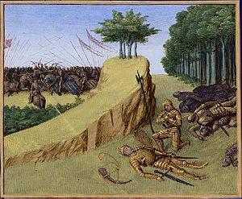
The Song of Roland
(La Chanson de Roland)
But before his honorable death in battle, Roland shows the reader the stages of the Hero’s Journey and many heroic archetypes. He demonstrates what it means to be a chivalrous knight – loyal to his king and country to the very end, overcoming his own character flaw and sacrificing himself for the greater good in the end. His story is the embodiment of the greatest Medieval romance ever written.

