Slide 1
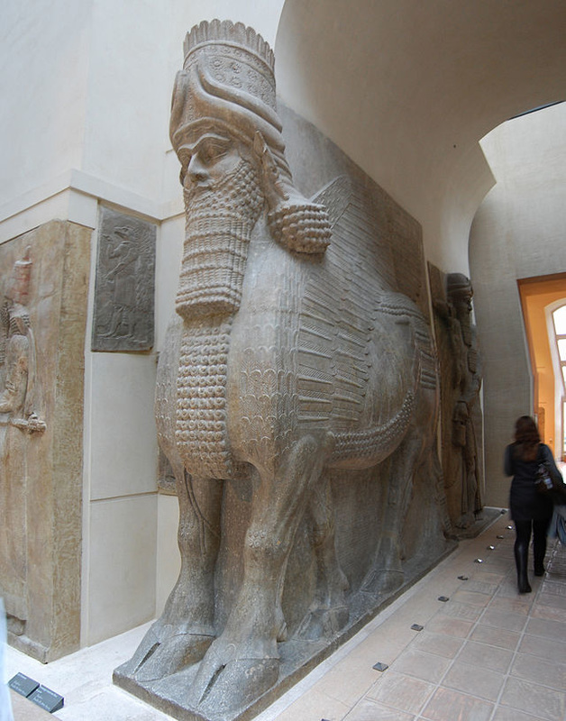
Lamassu from the citadel of Sargon II, Dur Sharrukin
Ethan Mahon
H Humanities Herndon A
16 September 2016
now Khorsabad, Iraq, Mesopotamia, Neo-Assyrian
The Lamassu is a human-headed winged bull. It combines features of man, bull, and bird to symbolize protection.
The Lamassu is in the round which means it can be seen from all of its sides.
These statues had more than just a decorative purpose. They were used architecturally to hold up the arches of the doorways they guarded.
It is for meters in height, four meters wide, and one meter deep.
The Lamassu actually has five legs, but it is not obvious. The reason for this is so that from the front it appears to be standing, and from the side it appears to be walking.
Lamassu were genies built to guard gates of cities and palaces. They were usually built in pairs together.
Its horns represent its divinity which horns often did in art from this time period.
Each one was carved from a single block of limestone.
The Lamassu was carved in a relief which means it is not a free standing sculpture, but it is attached to a stone.
There were actually many pairs of Lamassu created around this time with varying features, such as the feet of lions instead of the feet of bulls as depicted above.

