Slide 1

French Revolution
In the late 1780’s, the people of France reacted to food shortages, corrupt governments, greedy nobles, and political oppression by embracing new ideas and promised a more equal and democratic society. Attempts to compromise with the king failed and in 1789, a violent revolution broke out in Paris and spread throughout the entire country.

Slide 2
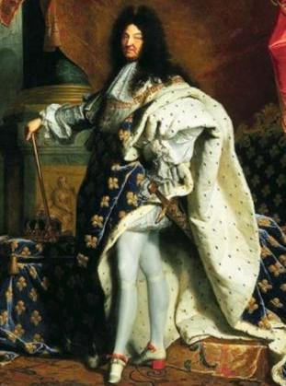
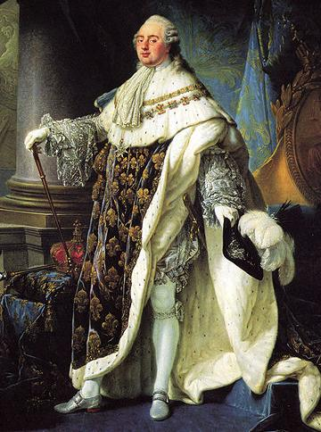
Reasons for the French Revolution
In the 1700s, France was the cultural capital of Europe, home to numerous Enlightenment thinkers, & had wealth from colonies
King Louis XIV was the most powerful king in Europe; After his death in 1715, Louis XV & Louis XVI continued to rule France as absolute monarchs
But, political & economic problems led to the French Revolution in 1789
King Louis XIV
King Louis XVI
Notes:
BOURBON DYNASTY
HENRY IV of France, 1553-1610, king of France (1589-1610) Edict of Nantes 1598
LOUIS XIII, 1601-1643, king of France (1610 - 1643), son of Henry IV
LOUIS XIV, 1638–1715, king of France (1643–1715), son of Louis XIII, personal rule after 1661
LOUIS XV, 1710–74, king of France (1715–74), great-grandson of King Louis XIV
LOUIS XVI, 1754–93, king of France (1774–92), third son of the dauphin (Louis) and Marie Josèphe of Saxony, grandson and successor of King Louis XV. Executed in 1792.

Slide 3
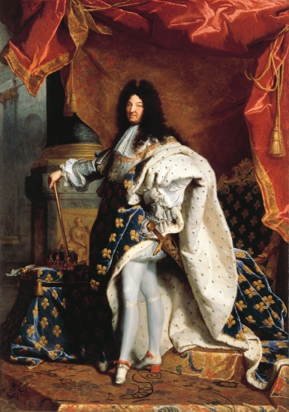

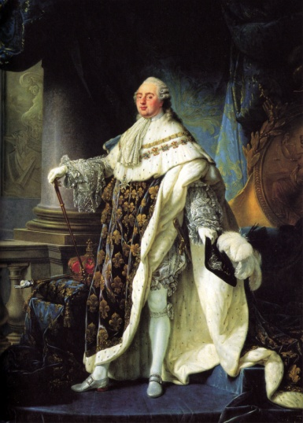
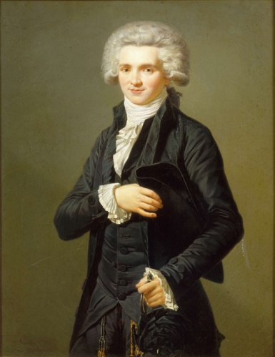
Key People
Louis XIV – Ruler of France until 1715. Known as the “Sun King” & for his palace, Versailles. His wealth & power were the envy of every monarch in Europe.
Louis XVI – Last Bourbon king of France known for his ineptitude and insensitivity to the plight of the French peasants
Marie Antoinette – Wife of Louis XVI, did not say “Let them eat cake”
Danton – Revolutionary leader known for his fiery speeches & pleas for equality & justice for the poor of France
Robespierre – Cruel & brutal leader during the Reign of Terror
Napoleon – Military leader & dictator of France from 1804 – 1815 known for his governmental reforms & bloody wars in Europe
Baron von Metternich – Austrian leader of the Congress of Vienna in 1815 who led the conservative backlash of the upper classes who wished to prevent further revolutions

Slide 4

Key Terms
Old Regime – The social structure observed in France before the revolution.
Estates General – when the 3 Estates met to legislate new law.
Coup d'état – an overthrow of the state or a toppling of a government & its rulers
Guillotine – a device of execution, in which a blade & the force of gravity severed a head of its victim
Coalition – gathering of countries cooperating to defeat France & later Napoleon
Jacobin – radical club in Paris, also used as a description of revolutionaries by non-French people

Slide 5
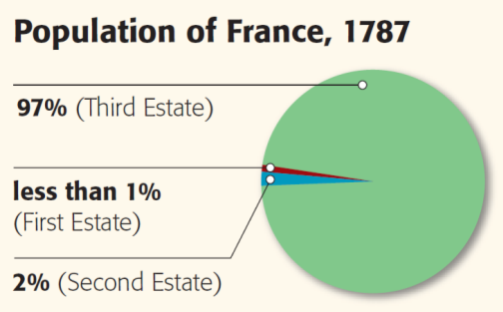
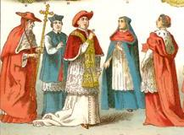
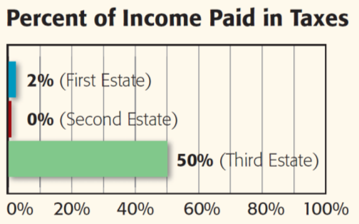
One problem was France’s unequal social hierarchy that was made up of three classes (called estates)
The clergy of the Roman Catholic Church made up the First Estate
Owned 10% of land
in France but paid little in taxes to the gov’t

Slide 6
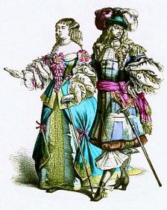
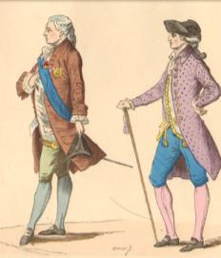
One problem was France’s unequal social hierarchy that was made up of three classes (called estates)
The Second Estate was made up of rich nobles
Owned 20% of French land but were exempt from paying taxes

Slide 7
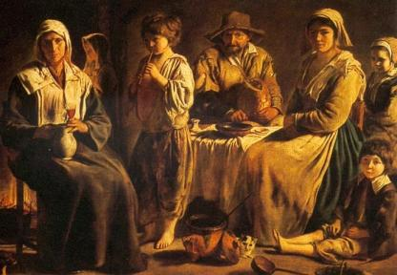
One problem was France’s unequal social hierarchy that was made up of three classes (called estates)
The Third Estate made up 97% of the population & included poor peasants but also the well-educated middle class (bourgeoisie)
This group paid 50% of their income in taxes

Slide 8
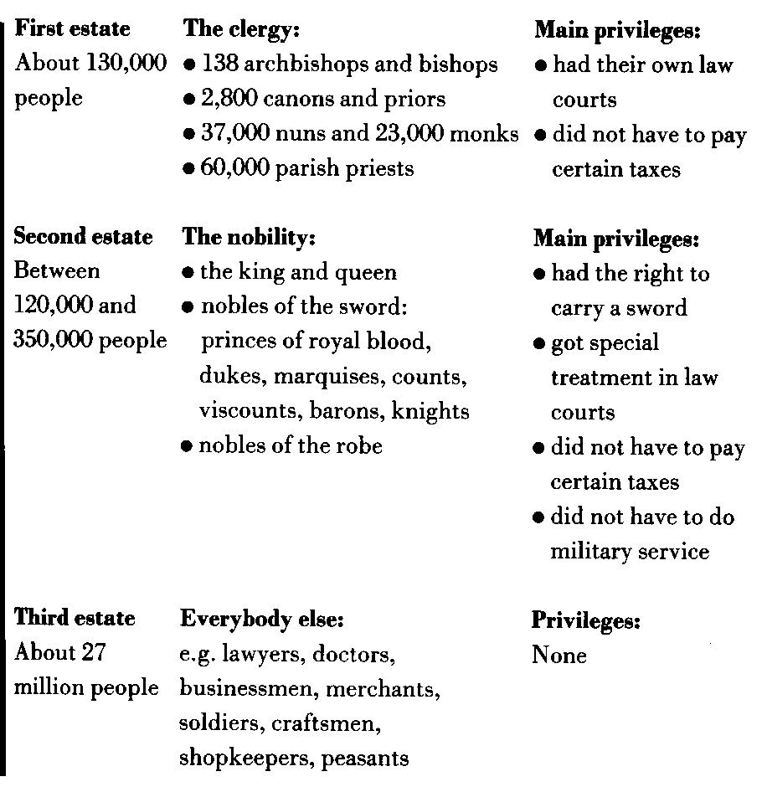

Slide 9
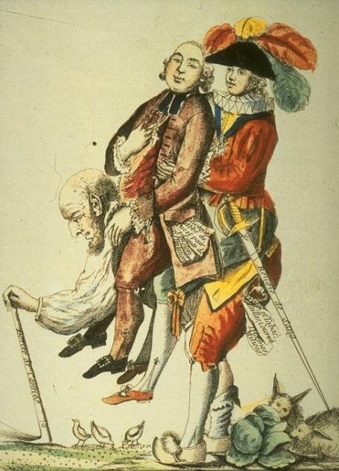
The members of the Third Estate resented the special treatment the First & Second Estates received
Members of the Third Estate gained inspiration from the Enlightenment ideas of John Locke, Voltaire, & Rousseau
After the success of the American Revolution,
the Third Estate began demanding democracy, equality, & liberty in France
Notes:
BOURBON DYNASTY
HENRY IV of France, 1553-1610, king of France (1589-1610) Edict of Nantes 1598
LOUIS XIII, 1601-1643, king of France (1610 - 1643), son of Henry IV
LOUIS XIV, 1638–1715, king of France (1643–1715), son of Louis XIII, personal rule after 1661
LOUIS XV, 1710–74, king of France (1715–74), great-grandson of King Louis XIV
LOUIS XVI, 1754–93, king of France (1774–92), third son of the dauphin (Louis) and Marie Josèphe of Saxony, grandson and successor of King Louis XV. Executed in 1792.

Slide 10
Causes
Disparity between rich and poor
Unresponsive monarchy
Food and famine of the 1780’s
Success of the American Revolution
Ideas of the Enlightenment
Corruption at all government levels

Slide 11

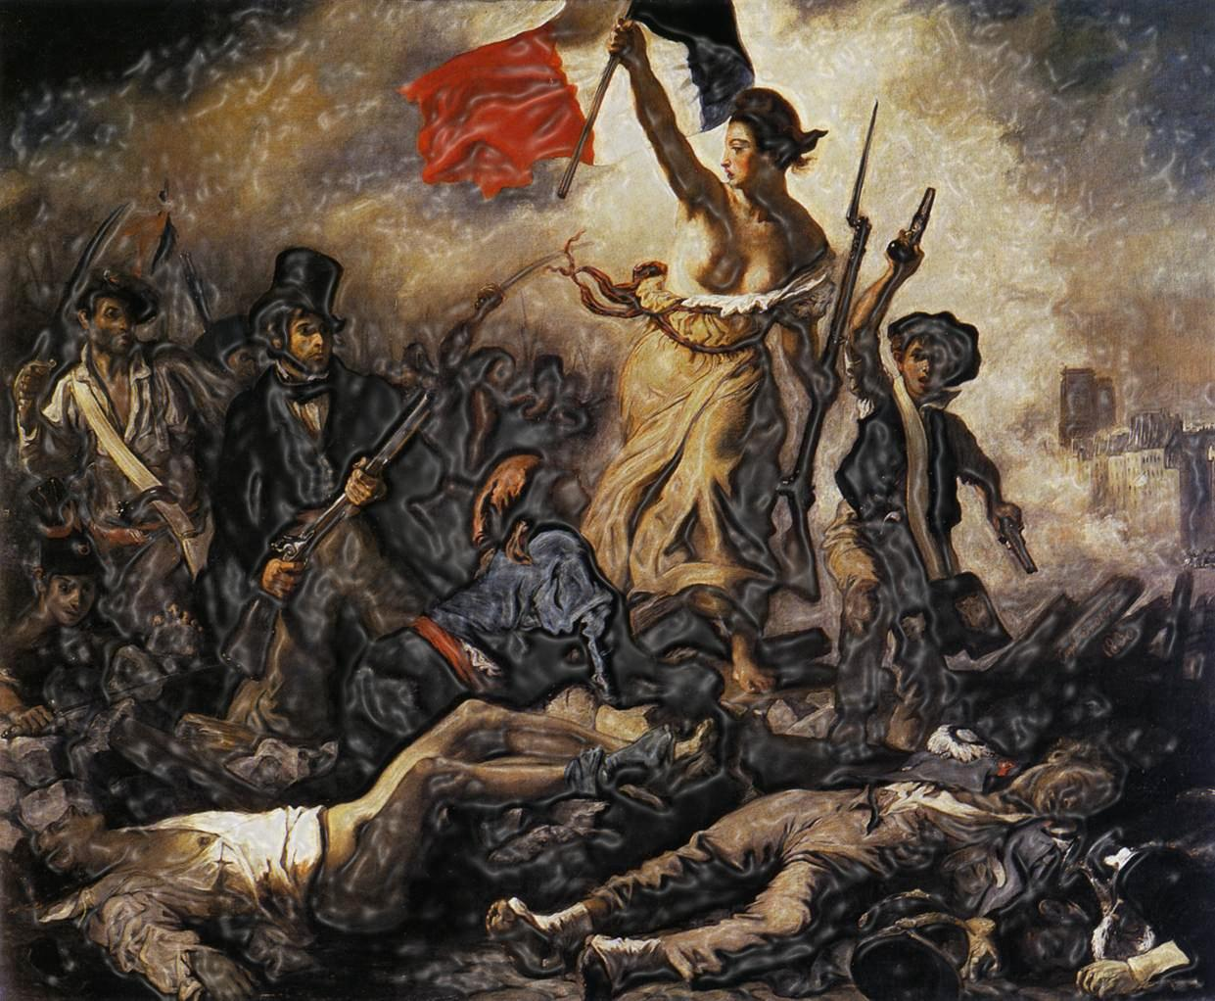
French Revolution Timeline
1788 – 1799

Slide 12
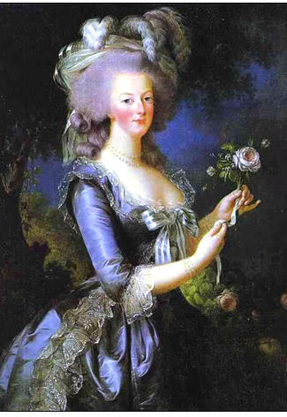
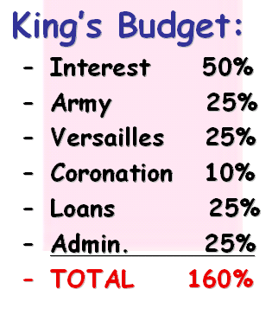
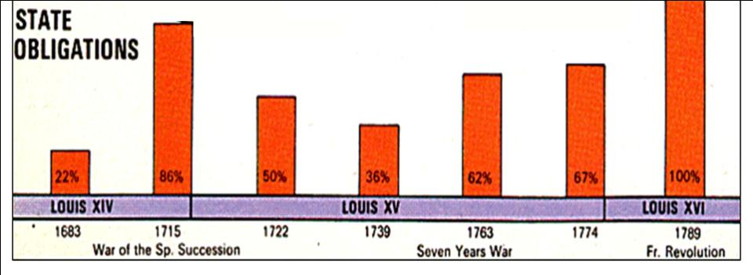
Social tensions were made worse by a growing financial crisis in the 1770s & 1780s
The French government faced massive debts due to decades of lavish spending, expensive wars, & poor economic planning
GOVERNMENT DEBTS
(percentage
of total government revenue)
By 1789, half the budget went towards interest on the national debt; 25% of people were unemployed
The excessive spending by
King Louis XVI & his wife Marie Antoinette angered French citizens
Marie Antoinette,
“Madame Deficit”

Slide 13
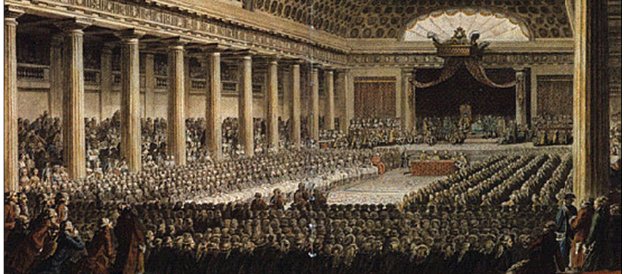
By 1789, France was out of money & faced a serious financial crisis
Louis XVI called an emergency meeting of the Estates-General where members from all 3 classes could advise the king

Slide 14

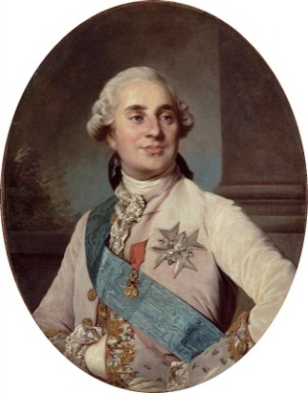
1788
August 1788 – Louis XVI announced meeting of the Estates-General to be held in May 1789
Louis XVI inherited the debt (by Louis XV, his grandfather)
  Added to the crisis → War for American Independence (1775-1783)
  Appointed several ministers to deal with the financial crisis
  Louis forced to give into the demands of the Parlement of Paris
  Convened the E-G → led to the outbreak of the Rev
  Executed in 1793
Estates General medieval representative institution →not called since 1614
  Convened by Louis XVI in 1789 to deal with the financial crisis
  Parlements made recording his tax decree contingent upon a compromise vote in the E-G
  Consisted of the 3 Estates
  1 vote per Estate, w/the 1st & 2nd Estates usually outvoting the 3rd Estate

Slide 15
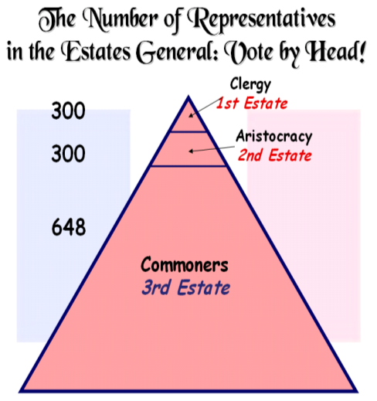
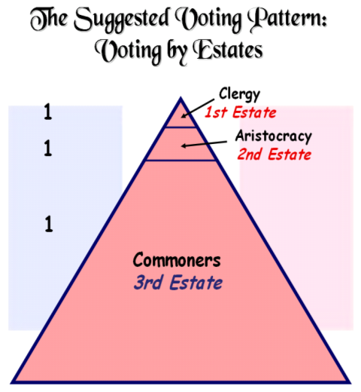
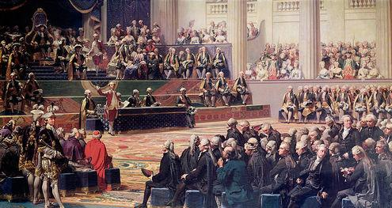
During the Estates-General, the First & Second Estates voted to increase taxes on the Third Estate
The First & Second Estates decided to vote by order
(1 vote per estate) rather than by head (by person)
These decisions angered the members of the Third Estate who believed their rights were being violated

Slide 16
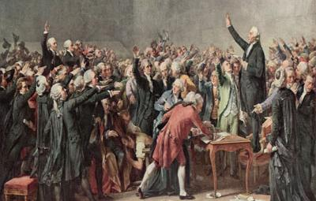
The Third Estate formed a new
National Assembly
to make laws for the French people
In 1789, the National Assembly swore to a Tennis Court Oath promising a new constitution & limitations on the king’s power

Slide 17

May – June 1789
May 5, 1789 - Estates-General convenes (E-G)
June 17, 1789 - Third Estate declares itself the National Assembly
3rd Estate comprised the commoners of France (rich merchants → poor peasants)
  3rd Estate left the E-G & declared itself the National Assembly
National Assembly 3rd Estate after it separated from the E-G
  Agreed to stay together to make a constitution
  Claimed to legitimately represent the French population
  National Assembly dissolved in 1791 → new elections could take place under the new constitution
June 20, 1789 - Oath of the Tennis Court
Oath of the Tennis Court- 3rd Estate locked out of the E-G
  Met at a nearby indoor tennis court
  Pledged to remain together to draft & pass a new constitution guaranteeing a limited monarchy

Slide 18
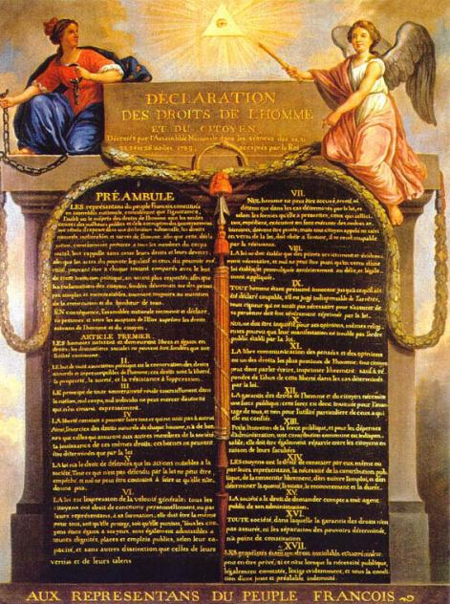
The National Assembly wrote their revolutionary ideals in the Declaration of the Rights of Man and of the Citizen which said:
“Men are born free and equal in rights”
Rights include “liberty, property, security, & resistance to oppression”
It guaranteed freedom of speech, &freedom of religion, & equal justice

Slide 19
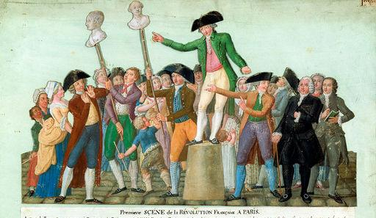
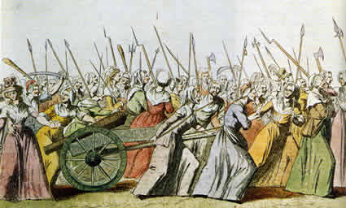
Meanwhile, the economic crisis continued
Citizens were without food & faced starvation
Angry protestors in Paris demanded new reforms

Slide 20

July – October 1789
July 14, 1789 - Storming of the Bastille
Bastille- large armory & prison for debtors (Paris)
  Symbol of royal oppression & military rule
  Mob of the poor sacked the Bastille (July 14, 1789) giving the masses arms
  Poor took action after being inspired by the National Assembly
July 20, 1789 - Revolt of the peasantry begins
August 26, 1789 - Declaration of the Rights of Man and Citizen issued (See pg. 634-636)
Declaration of the Rights of Man and Citizen sounded like the US Declaration of Independence (1776)
  brought together liberal & progressive Enlightenment ideas (Locke & Montesquieu)
  Noting that liberty is a "natural" & "imprescriptible" right of man
  “Men are born & remain free & equal in rights"
  Exemplified the idealistic intentions of the liberal leaders of the revolution
October 1789 - Parisian women march to Versailles and forces Louis XVI to return to Paris
Versailles- all members of royalty & high gov’t officials & select nobles lived there
  Angry & poor women of the Paris marched to Versailles
  Brought the royal family back to Paris under guard to deal w/the food shortage

Slide 21
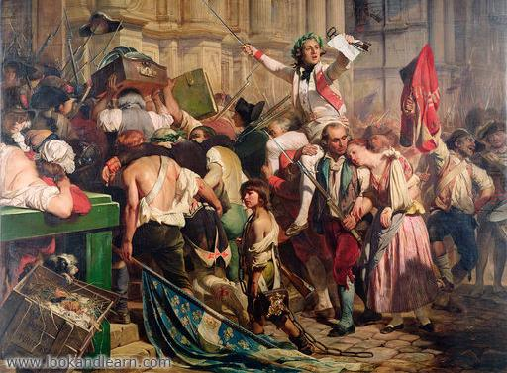
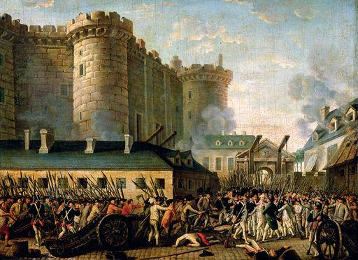
When rumors circulated that the king was going to send his army to Paris, citizens attacked the prison Bastille to seize weapons to defend themselves
The storming of the Bastille in 1789 represented the beginning of the French Revolution

Slide 22

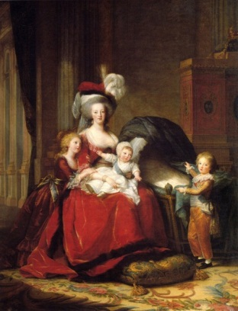
1790 – 1791
February 1790 - Monasteries and convents dissolved
July 1790 - Civil Constitution of the Clergy issued
Civil Constitution of the Clergy- transformed priests into paid agents of the state
  France appointed its own bishops & priests. (Right over Rome)
  Angered Pope Pius VI → denounced revolution as godless
June 1791 - Louis XVI and family attempt to
flee Paris, but are captured and returned

Slide 23
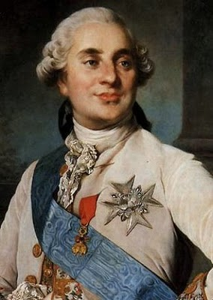
In 1791, Louis XVI
finally agreed to a new constitution that limited his power & created a limited monarchy
But, Louis XVI failed to work with the National Assembly & France’ problems continued
Fearing the spread of France’s revolutionary ideas, Austria & Prussia assembled armies to restore France’s absolute monarchy

Slide 24

1792 – January 1793
April 1792 - France declares war on Austria
Declaration of war against Austria & German states
  For harboring émigrés (people who left France)
  Austria & Germanies favored a strong French monarchy
August 10, 1792 - Storming of the Tuileries
Tuileries- palace in Paris → king & family placed under house arrest after forcibly taken from Versailles
  Removing the royal family, the people to keep a close watch on royal actions
  Forced the King & Queen to witness the horror of bread shortages in the city
  King & Queen were placed in prison
January 1793 - Louis XVI executed

Slide 25
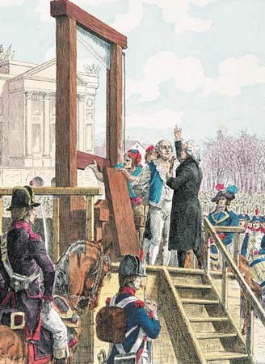
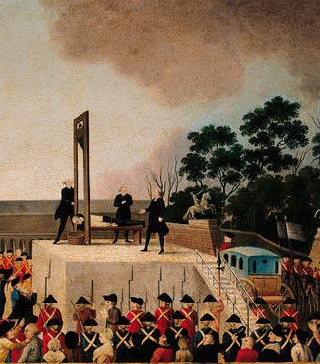
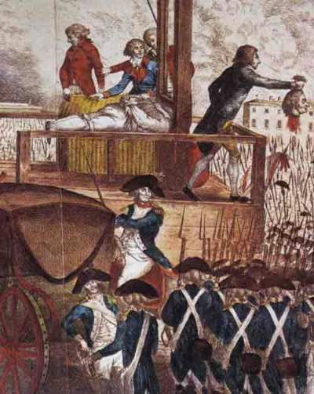
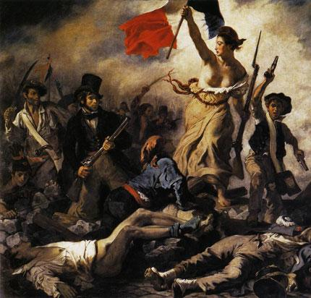
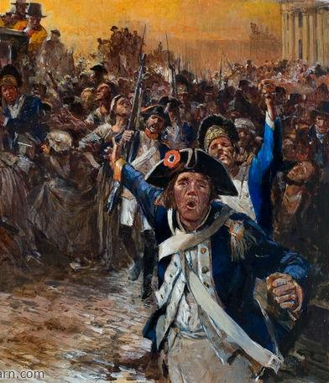
In 1792, radicals took control of France & made important decisions:
War was declared against Austria & Prussia and 300,000 French soldiers were drafted into a national army in order to defend France
The French monarchy was overthrown & democratic republic
was created called the National Convention
In 1793, King Louis XVI was arrested, convicted of treason, & executed by guillotine
The slogan of the French Revolution became:
“Liberty, Equality, Fraternity”

Slide 26
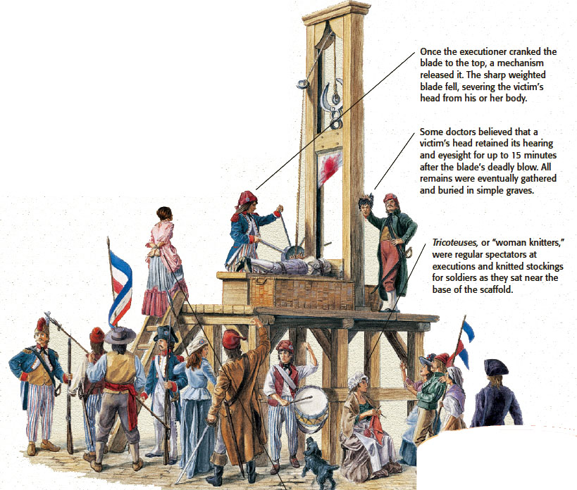
The Guillotine

Slide 27

July 1793 - 1794
July 1793 - Maximilien Robespierre leads the Committee of Public Safety
Robespierre- political leader of the radical wing of the leftist Jacobins
  Chaired the Committee of Public Safety
  Pursued a planned economy & vigorous mobilization for war
  Reign of Terror attempted to silence enemies of the Rev to save France from invasion
Committee of Public Safety- Faced war abroad & economic/peasant problems at home
  National Convention handed dictatorial powers →12-man body
  Chaired by Robespierre to restore order
  Reign of Terror → over 250,000 deaths
1793-1794 - Reign of Terror
Reign of Terror- organized by Robespierre & Committee of Public Safety
  9-month period in France
  Systematic oppression & mass execution of potential enemies of the radical Rev

Slide 28
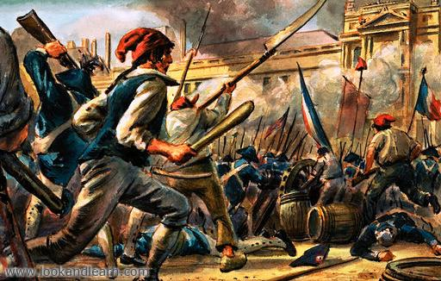
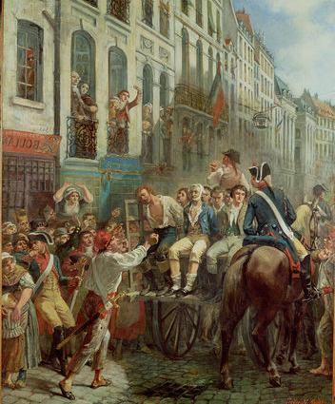
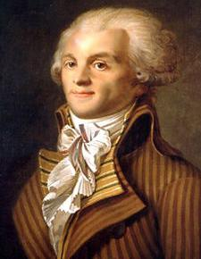
The radical leaders of the National Convention feared that “enemies of the revolution” would try to overthrow the new republic
In 1793, radical
Maximilien Robespierre slowly gained control of the National Convention
From 1793 to 1794, Robespierre executed 40,000 “traitors” during an era known as the Reign of Terror
The Reign of Terror ended when French citizens turned on Robespierre
& executed him

Slide 29

July 1794 - 1799
July 28, 1794 - Robespierre is guillotined
1794-1799 - Thermidorian Reaction
Name given to the execution of Robespierre & reassertion of moderate power over the Rev
Brought the Rev back to the 1st stage of moderate changes designed to benefit the business classes of French society
1799 - Napoleon Bonaparte overthrows the Directory and seizes power
Napoleon Bonaparte- Corporal in the French army & leader of the 1799 coup that overthrew the Directory
  His leadership ends the French Rev & begins Napoleonic France/Europe
Directory- Created by the constitution during the Thermidorian Reaction
  Executive branch appointed by the legislative assembly
  Orchestrated an overthrow of the assembly & ruled dictatorially until overthrown by Napoleon

Slide 30
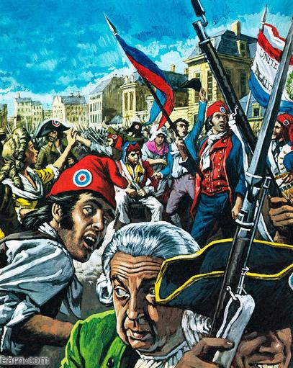
The revolution came to an end in 1795,
but France was in chaos
The economic crisis had not been solved & people faced starvation
England, Holland, Spain joined Austria & Prussia in the war against France
The National Convention was replaced by France’s third gov’t in six years called the Directory
The Directory proved to be ineffective & corrupt

Slide 31
Effects
Country bankrupted by war
Millions dead in Rev. & Napoleonic Wars
France isolated politically from the rest of Europe (Who would want to be their friend/ally?)
Monarchy restored in France
More equitable land distribution in France
New codes and laws written

Slide 32
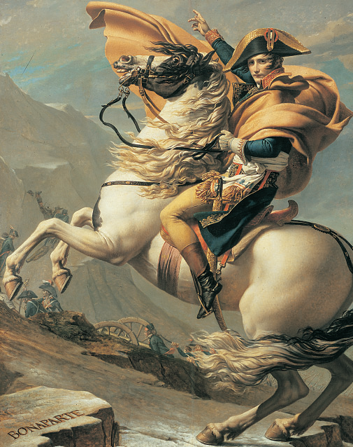
Napoleon Bonaparte
In 1799, a French military general named Napoleon Bonaparte led a coup d'état & seized power in France
As emperor of France, Napoleon introduced needed reforms, defeated foreign armies, & conquered a massive French empire

