Slide 1
Chinese Art
Yuan and Ming Dynasties

Slide 2
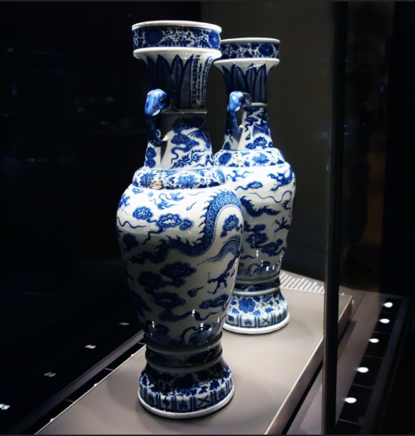
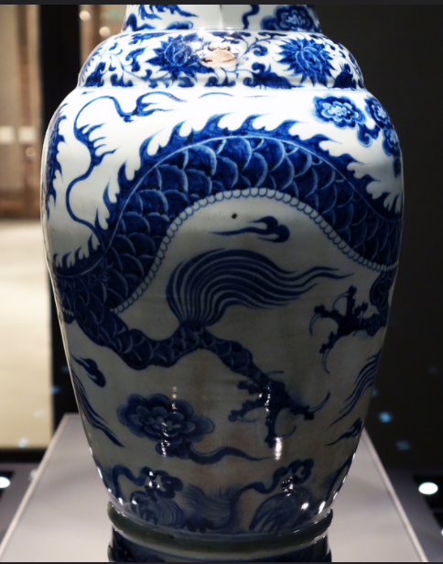
The David Vases. Yuan Dynasty, China. 1351 C.E. White porcelain with cobalt-blue underglaze.
https://www.flickr.com/photos/profzucker/9718291836/in/photostream/

Slide 3
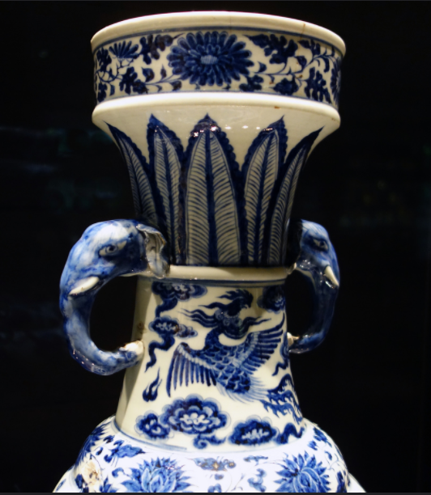
The David Vases are the best-known porcelain vases in the world because of the rare inscriptions around their necks, dating them to precisely AD 1351. When first discovered they were believed to be the oldest dated example of blue-and-white porcelain in the world. They are named after their most famous owner, Sir Percival David (1892-1964), who built-up one of the world's greatest Chinese ceramic collections. They were originally altar vases, commissioned by a man called Zhang Wenjin, and presented as an offering to a Daoist temple.

Slide 4
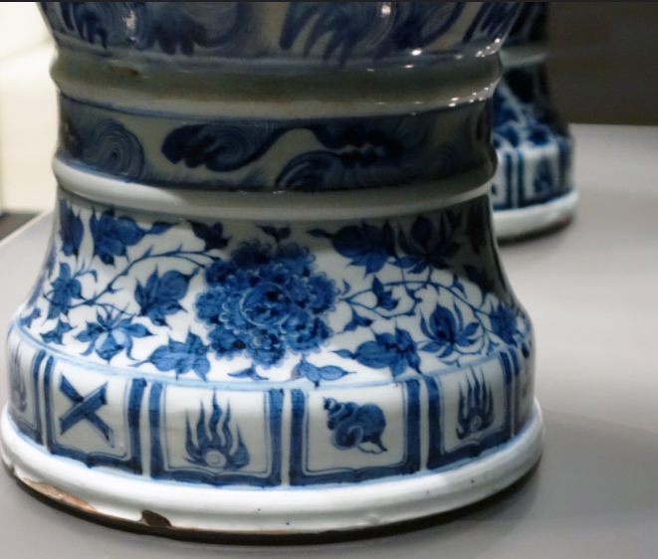
The David Vases were made during the reign of the foreign Yuan dynasty (1279-1368), when China was at the heart of a vast Mongol Empire. Trade flourished between China and the Middle East and cobalt, used to create the blue effect, came from the other side of the empire in Iran. Archaeologists have unearthed materials which now show that Yuan dynasty blue-and-white porcelain was made for several different markets, rather than solely for export as was once thought. Different consumers demanded specific forms, sizes and designs.

Slide 5
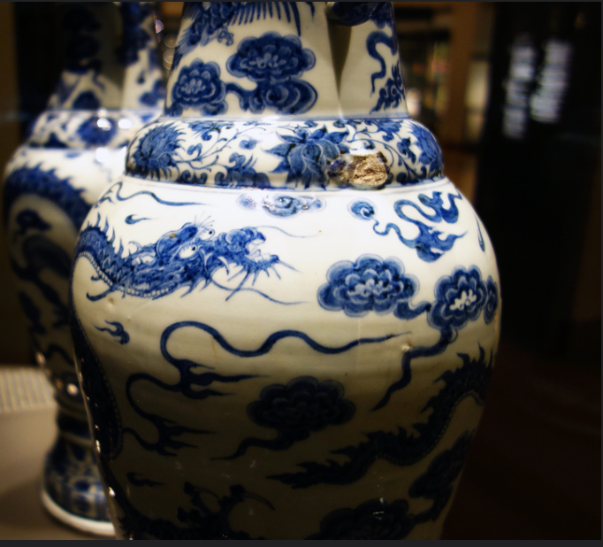
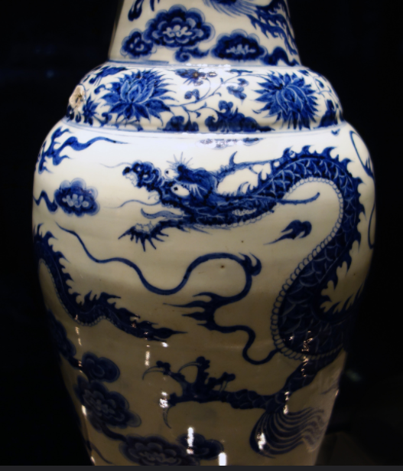
Two applied elephant head handles . Underglaze blue with scrolling four-clawed dragon, facing left with mouth open, in clouds around the main part. Band of scrolling peonies, overlapping plantain leaves and long inscription on upper part of neck, and phoenixes (one flying downwards) in clouds on lower part. Scrolling peonies on foot.

Slide 6
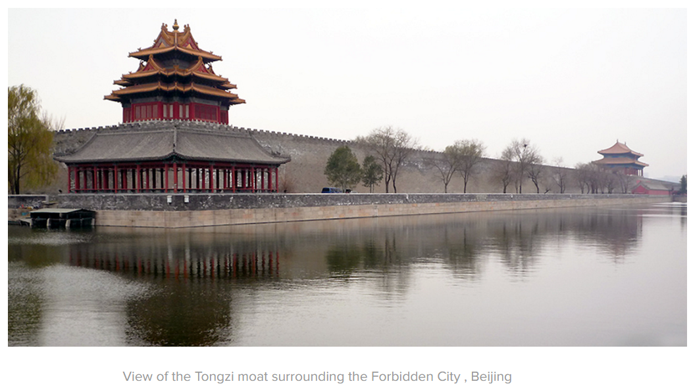
Forbidden City. Beijing, China. Ming Dynasty. 15th century C.E. and later. Stone masonry, marble, brick, wood, and ceramic tile.
The Forbidden City in the center of Beijing embodies the splendors of China’s imperial past and demonstrates the beauty of Chinese architecture which is a very important part of the Chinese tradition. It also indicates the world view of the Chinese people and their conceptualization of the cosmological order.

Slide 7
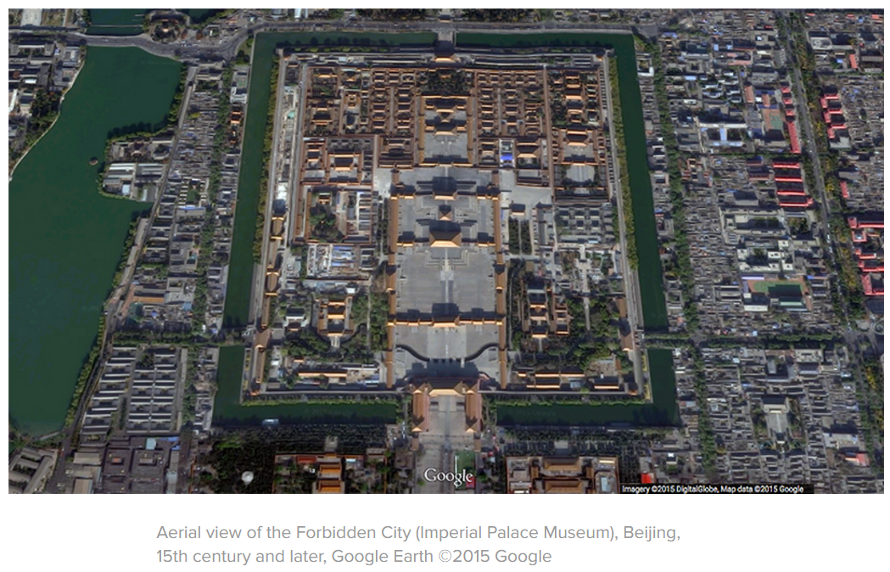
The Forbidden City was the imperial palace of the Ming and Qing dynasties. It is called the Palace Museum now. It lies 1 kilometer north of the Tian'anmen Square, with its north gate, the Gate of Devine Might (Shenwumen), facing the Jingshan Park. 960 meters long and 750 meters wide, the world largest palace complex covers a floor space of 720,000 square meters, having a total number of 9,999 buildings. The rectangular city is encircled in a 52-meter-long, 6-meter-deep moat and a 10-meter-high, 3,400-meter-long city wall, which has one gate on each side.
Generally, it was divided into two parts, the northern half, or the Outer Court where emperors executed their supreme power over the nation and the southern half, or the Inner Court where they lived with their royal family. 14 emperors of the Ming dynasty and 10 emperors of the Qing dynasty had reigned here over the span of about 500 years.

Slide 8
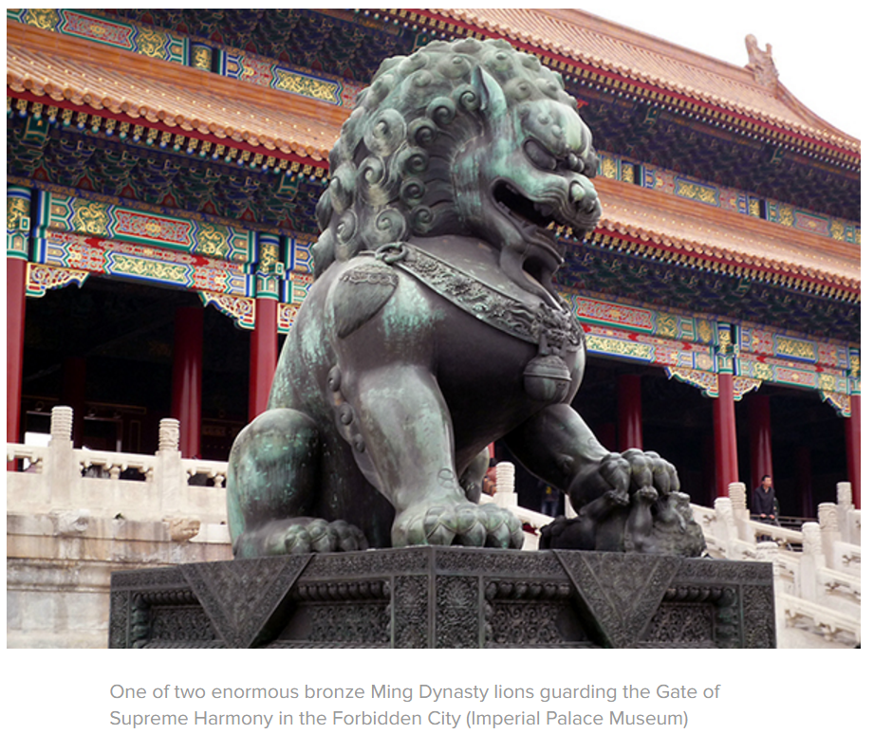
Since yellow is the symbol of the royal family, it is the dominant color in the Forbidden City. Roofs are built with yellow glazed tiles; decorations in the palace are painted yellow; even the bricks on the ground are made yellow in special places. However, there is one exception; the royal library, has a black roof. The reason is that it was believed black represented water which could extinguish fire.

Slide 9
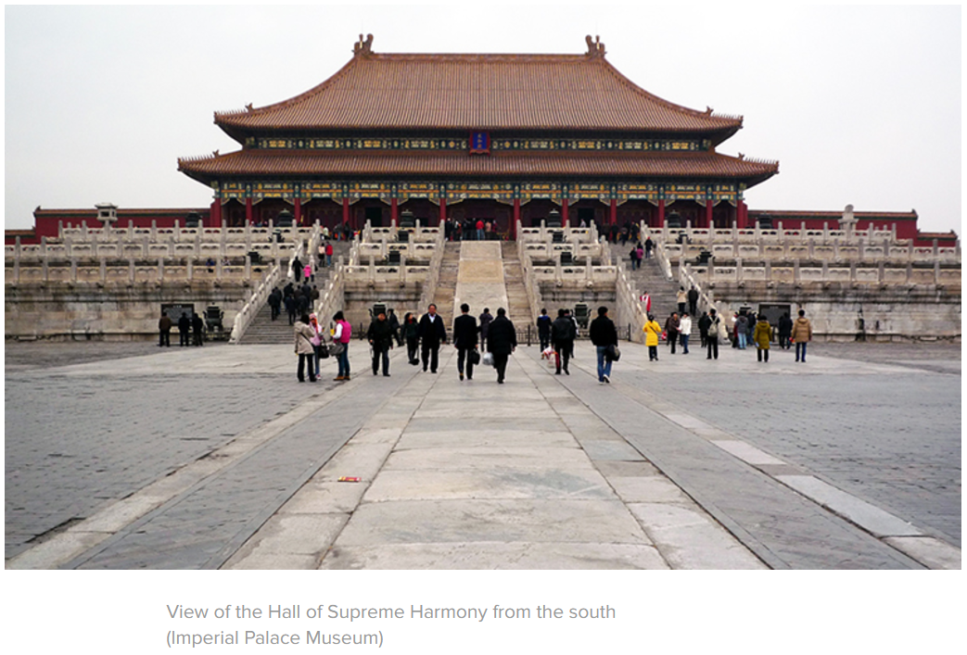
Construction of the palace complex started in 1407, the 5th year of the reign of the third emperor of the Ming dynasty, and was completed 14 years later in 1420. It was said that a million workers including 100,000 artisans were driven into the long-term hard labor. Stones needed were quarried from Fangshan, a suburb of Beijing. It was said a well was dug along the road every 50 meters in order to pour water onto the road in winter to slide huge stones on ice into the city. Huge amounts of timbers and other materials were all freighted from faraway provinces.
The bricks of the wall are made from white lime and glutinous rice while the cement is made from glutinous rice and egg whites, and these incredible materials make the wall extraordinarily strong.

Slide 10
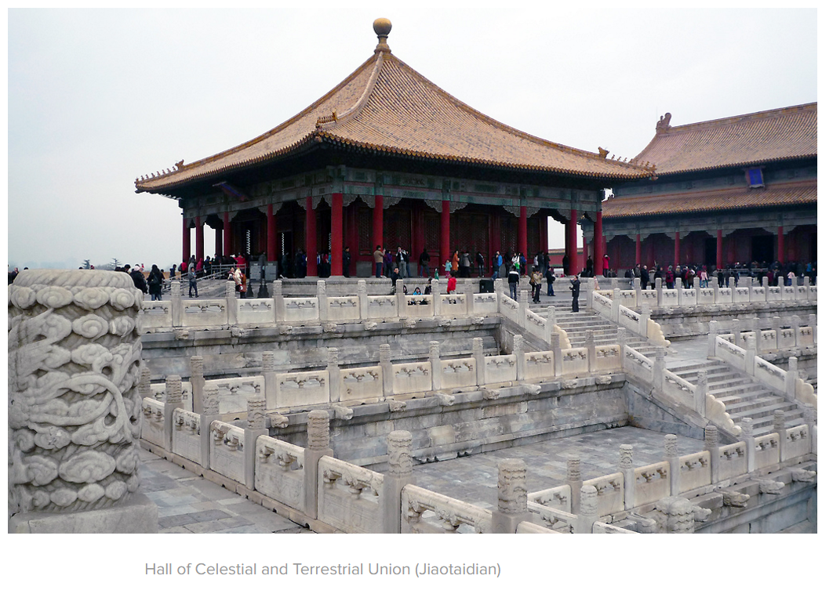
The outer courts contained three great audience halls; “The Hall of Supreme Harmony”, The Hall of Middle Harmony” and “The Hall of Protecting Harmony”. All these buildings were wooden framed structures. These three halls would house such events as the crowning of a new emperor, the emperor’s wedding and the birthdays.
The buildings in the complex were mostly red in color and a dragon motif was used throughout as symbol of goodness and strength. A dragon with 5 claws holding a flaming pearl in waves or clouds was the symbol of the emperor. The eaves of the imperial palace were decorated with carvings of dragons and other Chinese mythological creations.

