Slide 1
Japanese Art

Slide 2
Todai-ji. Nara, Japan. Various artists, including sculptors Unkei and Keikei, as well as the Kei School. 743 C.E.; rebuilt c. 1700. Bronze and wood (sculpture); wood with ceramic-tile roo ng (architecture).

Slide 3
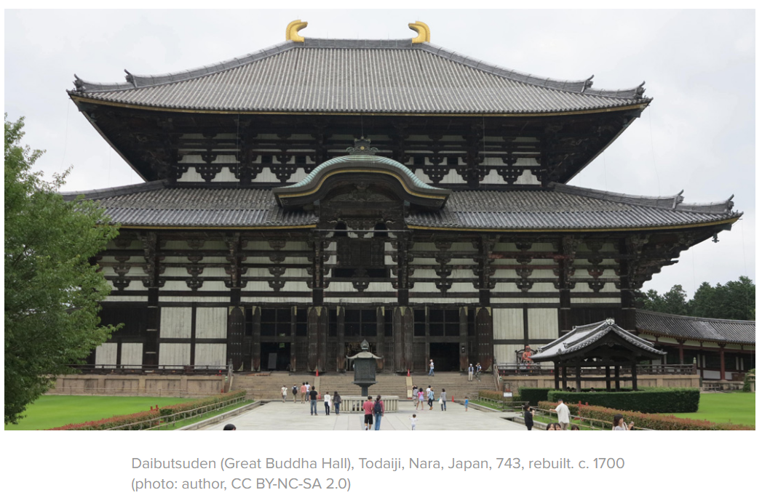
The Daibutsuden (Great Buddha Hall) at Todaiji was originally completed in 751 CE, and was larger than the current building, which was rebuilt in 1692-1709 after the original burned during the Sengoku Wars. Even though the current building is only 2/3 of the width of the original, this one is still truly enormous.
The temple is the largest wooden building in the world.
The Daibutsuden is 187 feet (57 meters) wide, 166 ft. (50.5 m) deep and 160 ft. (48.7 m) tall. The enormous roof weighs over 3020 tons, and is covered with 112,000 roofing tiles. 62 massive pillars support the structure, each roughly 25 feet in circumference.

Slide 4
Emperor Shomu constructed the temple. This is historically important because one of the Emperor’s goal was to unify Japan through religious and imperial power. The spreading of Buddhism contributed the decline of clans and eventual unification of political groups.
The original building was 86 meters wide (282 ft.), and was even more spectacular than this one. There were issues finding the materials in Edo-period Japan to make an exact reconstruction. The original building was built in the style of a Chinese palace, with huge red columns, a yellow ceiling, green window frames, white walls and a black tile roof.
The Daibutsu was cast first (after workmen dug down 8 ft. to firm ground and built the platform and a wooden framework, covering the framework with two clay molds), after which the 62 giant columns were raised and the building was constructed. The two critical kouryou (arched transverse tie beams, called rainbow beams) for the section over the Daibutsu had to be 23.1 meters (76 feet) long, and required a dedicated search all over Japan for pine trees of the correct size, strength and quality. At the ends of the roof-ridge are Shibi, curved talismans intended to protect the building against fire.

Slide 5
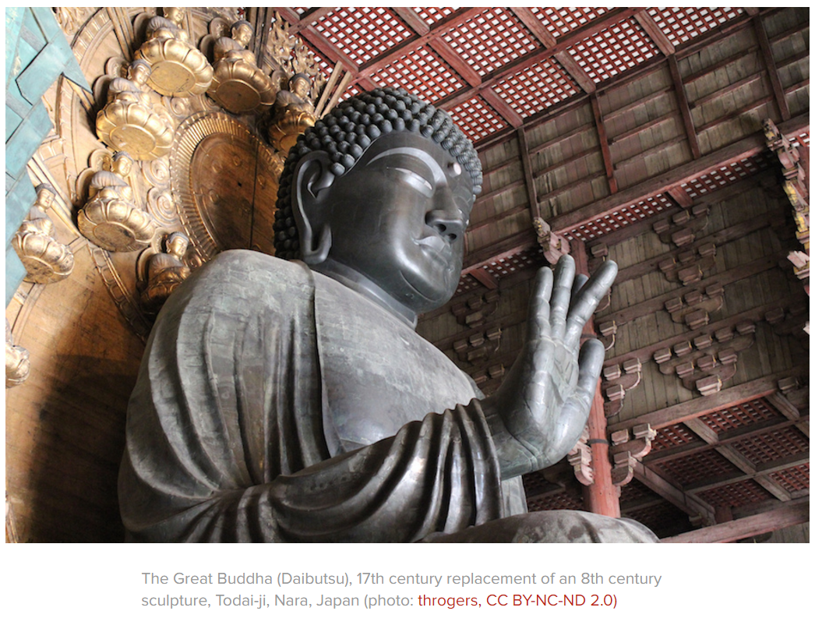
The Great Buddha Hall houses a 53-foot bronze image of the Cosmic Buddha, inspired by Chinese colossal statues.
It was made of copper and bronze, weighs 250 tons and stands 30 meters tall.
It was cast in a mold on site.

Slide 6
The Daibutsu was cast on site using nearly all of Japan’s bronze production for years. A wooden framework supported by a giant pillar was built, and then was covered with clay to form a basic statue. Bronze was then poured in from the base into the space between the outer and inner molds. It weighs 500 metric tons: 437 tons of copper, 8.5 tons of tin, 968 pounds of gold, 2.5 tons of mercury (used in a plating amalgam) and 7 tons of wax. His palm is 30% larger than a king-sized bed. The Buddha is seated with the palm of his right hand extended forward. This is one of the main five gestures of the hands and means "fear not" and “conversion of jealousy and envy into all-accomplishing wisdom.”
His intricate hairstyle is made of 966 bronze balls. Daibutsu has experienced a number of disasters. In 855 an earthquake broke the statue’s head off (restored in 861). In 1180 and 1567, fire melted his right hand. Due to all of the repairs, which were made over the years, the sculpture does not have the same character as the original. The hands were cast in the late 1500’s and the head was recast in the 1600’s, reflecting the styles of the times in which they were cast. http://buffaloah.com/a/virtual/jap/nara/nara.html

Slide 7
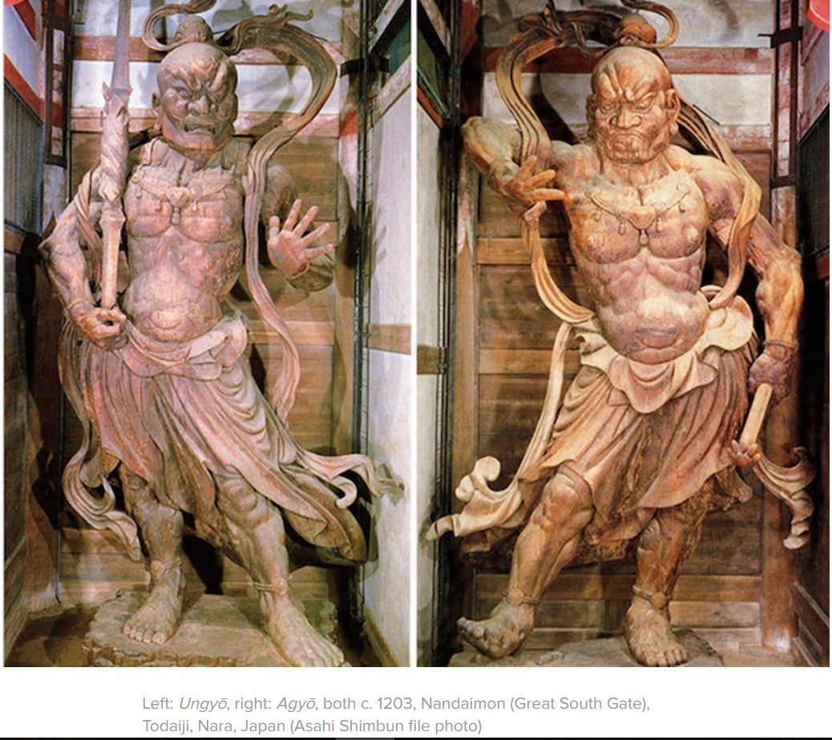
Along the approach to Todaiji stands the Nandaimon Gate, a large wooden gate watched over by two fierce looking statues. Unkei, the son of Kökei, created the two Nio or Deva Guardian Kings stand at the gate of the Todai-ji monastery. The pair are Ungyo, which by tradition has a facial expression with a closed mouth and is placed to the right of the temple, and Agyo, which has an open mouthed expression and is placed to the left of the temple. The wood carved statue is 28 feet high. The statues are housed in compartments at each side of the Great South Gate. The statues are designated national treasures together with the gate itself.
The Niō’s fierce and threatening appearance is said to ward off evil spirits and keep the temple grounds free of demons and thieves. In some accounts, the Niō were said to have followed and protected the Historical Buddha when he traveled throughout India. They have since been adopted by the Japanese into the Japanese Buddhist pantheon http://www.onmarkproductions.com/html/nio.shtml

Slide 8
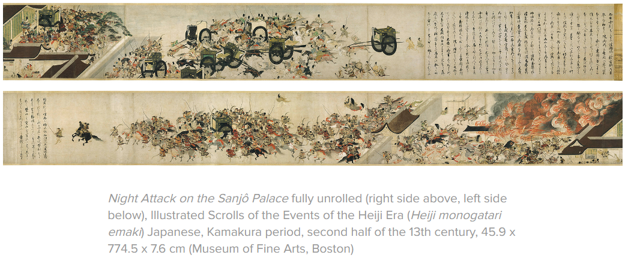

Slide 9
“A Night Attack on the Sanjo Palace” provides an excellent introduction to the genre of picture scrolls. The scrolls read from right to left, and all action flows to the left.
A few people hurrying flow into a confused throng of warriors and nobles, epitomized by a wayward bystander being crushed by an ox cart. Out of the confusion, attention shifts to the palace, where Fujiwara Nobuyori can be seen ordering the retired emperor into the cart.
Wisps of smoke appear, leading to a conflagration at the palace, with hapless supporters of the Taira being killed, and women of the palace attempting, with mixed success, to flee.
Gradually order is restored, and a band of warriors, including Fujiwara Nobuyori and his co-conspirator, Minamoto Yoshitomo, surround Go-Shirakawa's cart in a triumphant procession.

Slide 10
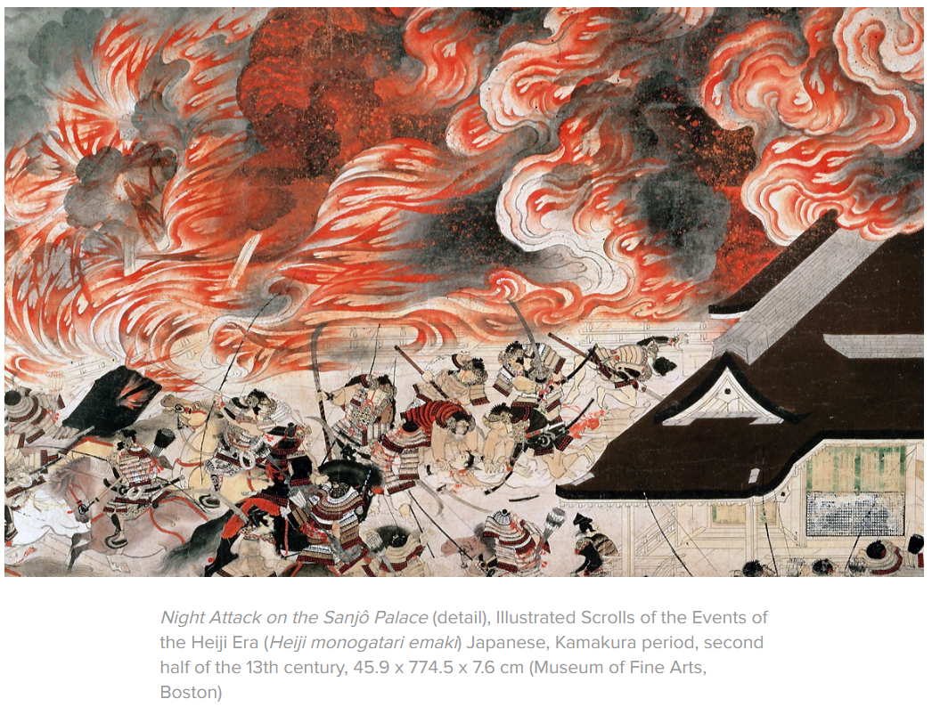
The Burning of Sanjo Palace is a hand scroll that depicts a war between two opposing forces trying to kill or catch the emperor.
The Heiji scrolls date from the thirteenth century and represent a masterpiece of "Yamato" style painting.
The scroll has brisk and lively line work, refined brushwork, and incorporates a bird’s-eye view.

Slide 11
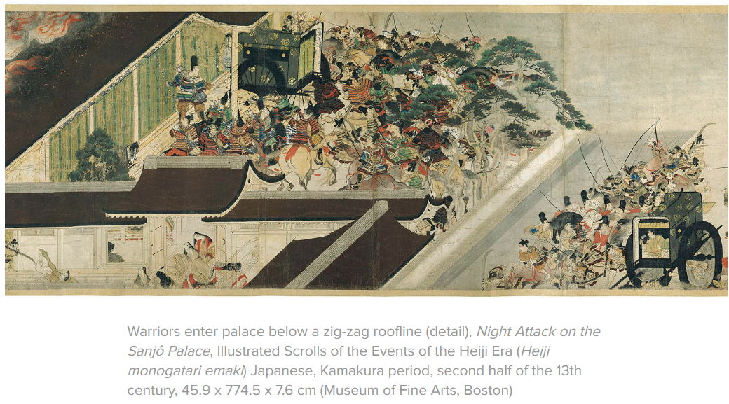
It provides a rare and valuable depiction of Japanese armor as it was worn during the early Kamakura era (1185-1333).
The battles for domination between the Minamoto and Taira became famous not only in medieval Japanese history, but in literature and art.
The work is full of action. Flames engulf palace; horses charge and warriors behead enemies. The court ladies try to hide.
Sense of energy and violence as it shows the savage depiction of warfare.
The scroll seems to convey a sense of eyewitness reporting even though artist is anonymous.

Slide 12
