Slide 1
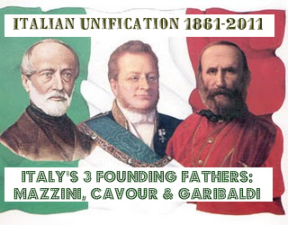
Italian Unification
1858 - 1870

Slide 2
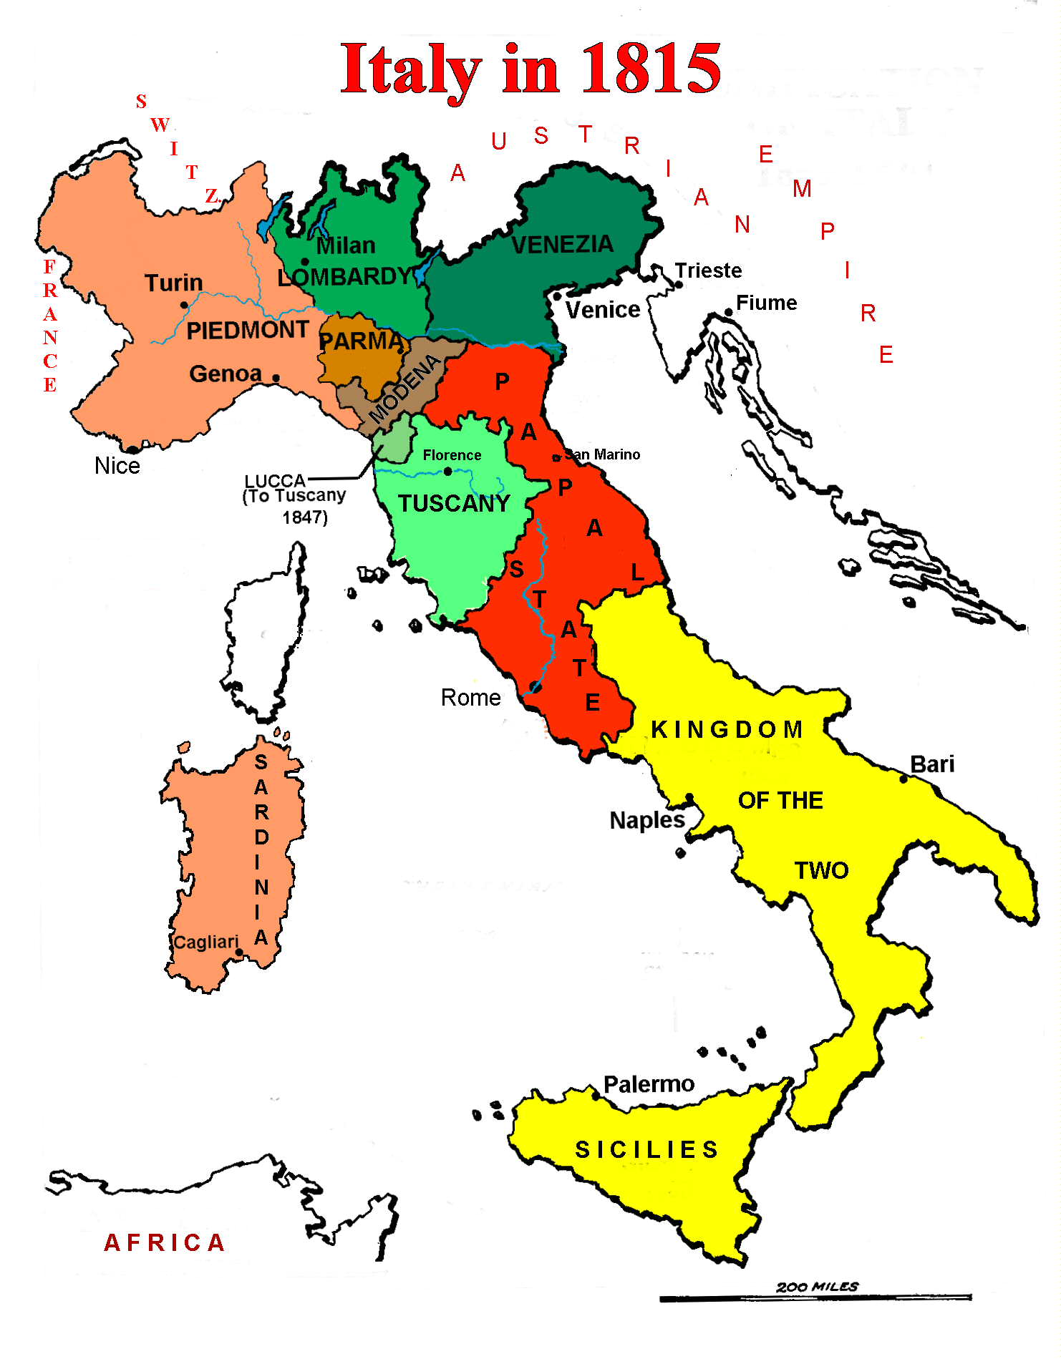
Since the time of the middle ages, Italy has been a collection of provinces, early to mid 1800s – Italy was ruled by Austria and the Pope.
Major Obstacles to Unification
Austrian Rule
Austria controlled major portions of Italy and had no wish to give them up.
The Pope
The Pope ruled the Papal States in central Italy; a strong national government would threaten church ownership of the lands.

Slide 3
GIUSEPPE’S
GIUSEPPE MAZZINI – founded Young Italy, “The Soul of Italian Unification” (secret society - called for the unity of Italy under a representative government)
Mazzini stirs up revolts in several cities that are quickly put down
Mazzini flees to France, and then later to Switzerland
He continues to promote unification with his writings
GIUSEPPE GARIBALDI – worked with Mazzini (1830s)
1848 – leads troops in the North against Austria, failed
1849 – attacks Rome in the hopes of setting up a more liberal government; take away some of the power of the Pope
Garibaldi goes into hiding to protect his freedom

Slide 4
Cavour & Emmanuel II
CAMILLO DI CAVOUR – believes in constitutional monarchy and industrial growth
1852 – movement gains new life
RISORGIMENTO – reawakening
Through the newspaper, stirs up anti – Austrian feeling, pushes for northern states to unite
1852 – KING VICTOR EMMANUEL II of Sardinia and Piedmont, names CAVOUR Prime Minister
While in Piedmont – encouraged building of factories and railroads increased trade with other nations
Built it up to win territory from Austria

Slide 5
Dealing with the Austrians
CAVOUR moves 1st against the Austrians
Arranges secret alliance w/France, then provoked war against Austria
Austria invades Piedmont, French aid the Italians
War ends in July 1859 – Piedmont receives the northern Italian state of Lombardy, previously controlled by Austria.
AUSTRIAN INVASION – increases nationalism, revs break out in:
Tuscany
Parma
Modena
1860 – with backing of France, these states join Piedmont and foundation of Italy is built.

Slide 6
The Return of Garibaldi
May 1860 – lands in Sicily with 1,000 Red Shirts
Defeat larger Bourbon professional army
Captures the Kingdom of the Two Sicilies, leaves Rome untouched
Garibaldi transfers control to king of Piedmont
KING VICTOR EMMANUEL – named king in March 1861
Cavour – dies before seeing the complete unification
With French support, the Vatican is set up
Rome becomes the capital of the Kingdom of Italy

Slide 7
Italy after Unification
Plagued by problems
Few natural resources, low industry
Population is poor and illiterate
Constitutional monarchy with parliament
1912 – all Italian men given right to vote, some traded votes for money
Roman Catholic church refuses to recognize Italy

Slide 8
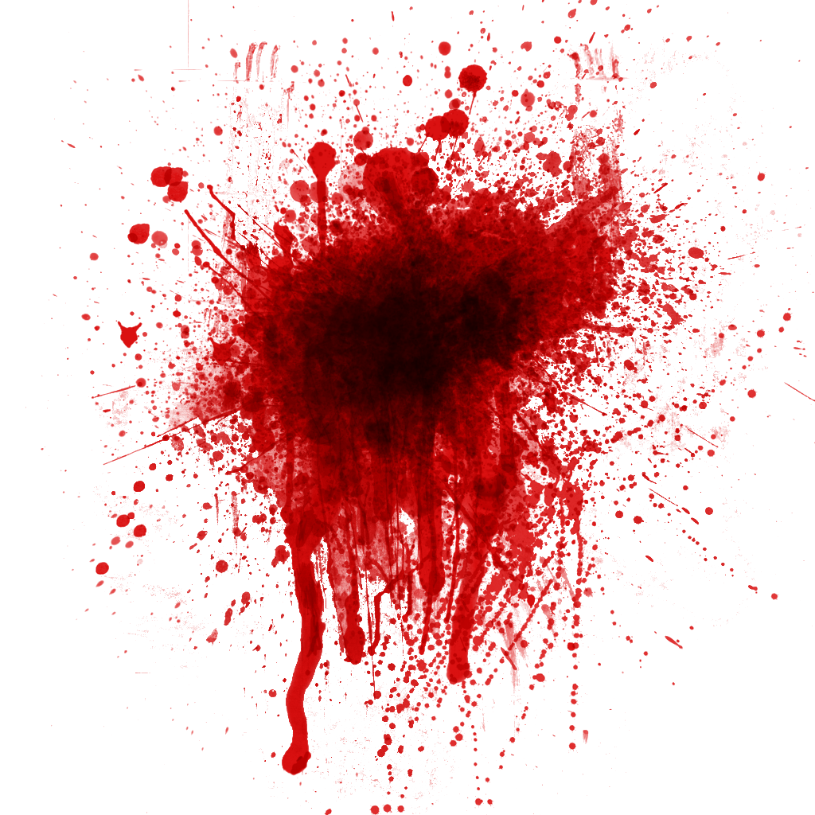
“Blood & Iron” The Unification of Germany
From 1790s – 1814, French troops conquered & occupied the area later known as the German Empire.
French domination: (Napoleon I helped German unification)
Helped to modernize and consolidate Germany
Sparked the first upsurge of German nationalism
Encouraged many of the middle-sized German states to absorb huge numbers of small independent territories
Powerful German princes (often in alliance w/France)
seized chance to enlarge their lands & refused to restore the annexed units to independence after Napoleon's defeat
# of independent & semi-independent states=1000 in 1792 (b/tw 300 & 400 fully independent)
25 years later approx. 30 – 40 states remained

Slide 9
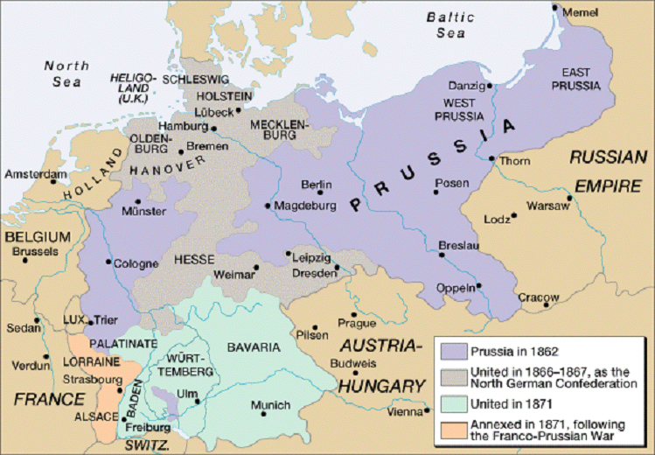
Germany was a loose confederation of 38 states ruled by princes or kings
PRUSSIA was the largest
Napoleonic Wars – caused formation of the Confederation of the Rhine
Fredrick William & Otto Von Bismarck – William appoints Bismarck chief minister
Bismarck will use war to achieve aim of German Unification
Obstacles-
Austria & France: feared having a large, strong nation at their border
Princes:
feared losing their power

Slide 10
Schleswig – Holstein
Bismarck starts 3 wars:
1. Schleswig – Holstein 2. Austro – Prussian War 3. Franco – Prussian War
1864 – Danish forces take Schleswig
Bismarck and Austria object and invade to “free” it from the Danes
Prussia wins decisively and forces the Danes to give up Holstein as well
Bismarck persuades Austria to govern Holstein; Prussia will govern Schleswig

Slide 11
Austro – Prussian War The 7 Weeks War (1866)
Huge quarrel erupts over the administration of Holstein, war brakes out
Bismarck persuades France and Russia not to aid Austria
Again, Prussia wins decisively:
Demonstrates Prussia’s military strength
Ends Austria’s influence over the future of Germany
THE NORTH GERMAN CONFEDERATION (1867)
Extends Prussian political power
Small German states band under Prussia’s leadership
Princes impressed by power, decide to join
4 major states in the south decide NOT to join:
North is Protestant, south is mainly Roman Catholic
South didn’t want to upset France
CONFEDERATION – bicameral legislature
Bundesrat & Reichstag
Bismarck is chief officer of the Reichstag, Presidency also held by a Prussian

Slide 12
Franco – Prussian War
Bismarck needs southern states, begins to stir up anti – French feeling in both the N & S
EMPEROR NAPOLEON III – eager for war:
Stop Prussia from gaining power
A victory over Prussia would make him popular w/French people
Prussian prince becomes king of Spain
Bismarck uses trickery playing on national pride to incite both sides to war.
EMS TELEGRAM-
From the Prussian Kaiser Wilhelm I →his Prime Minister Bismarck
When published (anticipated by Bismarck) triggered the Franco-Prussian War (1870-71)
Outlined the details of a disagreement b/tw Wilhelm & the French ambassador concerning the succession to the Spanish throne.
Bismarck subtly doctored the telegram →impression each side had insulted the other
July 1870 - France declares war
South German states blame France for war, come to the aid of the North
Napoleon III leads army, is quickly defeated and taken prisoner on September, 1870
January 1871 – Paris surrenders - - - a quick and total victory

Slide 13
Unification
The Treaty of Frankfurt (May 1871)
Germany gets Alsace and part of Lorraine (coal and iron)
France must pay reparations $$$$$
1871 – leaders of all of the German states meet at the Palace of Versailles
With much ceremony, the S joins the N → German Empire
King William I of Prussia became KAISER of
all Germany
Otto Von Bismarck was named Chancellor
Constitution was written
2 House legislature adopted
All men over 25 could vote for members of
the Reichstag
“Blood and Iron” is a success!

Slide 14
Germany after Unification
Bismarck creates strong army and navy
Coal and iron promote industry
High standard of living
Legislature exists, but Kaiser holds supreme power
Germans pass one of the first social insurance laws
SIMILARITIES B/TW ITALY & GERMANY:
Strong nationalistic emotions, compete for overseas colonies with other European nations
Spent large amounts of money and sacrificed many lives in race for these colonies.

