Slide 1
Inferno: Canto V
Circle 2: Lust

Slide 2
SUMMARY
The poets enter the Second Circle to see Minos in the way of the entrance, assigning sinners to their fates. While Minos allows Virgil and Dante to enter, he cautions them; they arrive on a cliff overlooking an intense whirlwind of carnal* souls, each guilty of allowing lust to get the better of them. Eternally whipping around in tempest-resembling winds, the souls wail out of agony. Virgil names some of the sinners, including Achilles, Cleopatra, Dido, and Semiramus. Out of pity, Dante calls to a couple in order to speak to them, pausing their movement in the wind. The woman, Francesca, tells Dante the story of their love, leaving him in tears. After Dante inquires as to how they sinned, Francesca continues to inform Dante that her and her lover shared a kiss while reading together. Dante is then overwhelmed to the point that he passed out.
*those who betrayed reason to their appetite

Slide 3
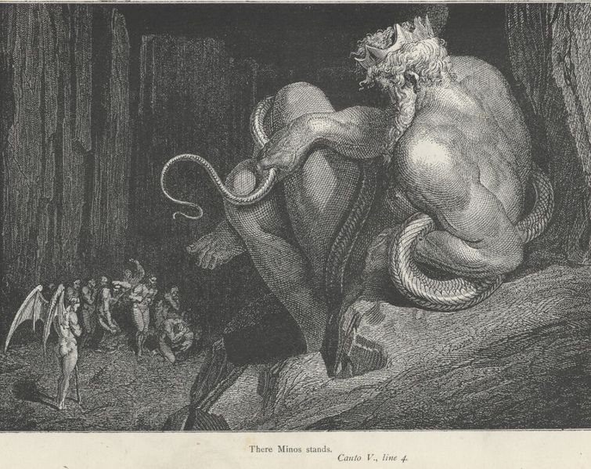
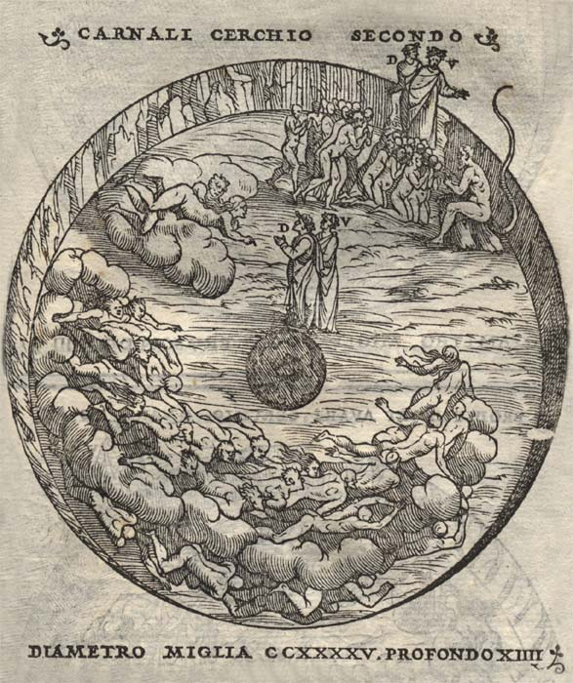
Extra Information
Circle includes famous lovers such as Cleopatra, Achilles, Helen of Troy, etc.
Minos’ tail wraps around him a certain number of times, this determines the circle of hell that the soul must go to (Supreme Judge of Underworld)
Lust circle is placed second because is is the least severe sin in hell

Slide 4
Question for Thought (Symbolism)
In the second level of Hell, committers of lust are held. They fly around naked, unable to land and be with another soul. What is the symbolism regarding their lack of ability to land and be with another naked, lustful soul?

Slide 5
Literary Analysis Skills
P.682 The divine comedy differs from the Arthurian romance; While the divine comedy focuses on love’s negative aspects and almost condemns most forms of love altogether, the Arthurian romance that Francesca describes in Canto V promotes and encourages love.

Slide 6
Literary Analysis Skills
P.679
Characterization: The creation or construction of a fictional character
Allusion: Indirect or passing message, an expression designed to call something to mind without mentioning it explicitly
Recall: Bring a fact into one’s mind, especially so as to recount it to others
Interpret: Understand an action, mood, or way of behaving as having a particular meaning or significance

Slide 7
Lines to Analyze
Lines 40-45
As the wings of wintering starlings bear them on
In their great weeling flights, justso the blast
Wheeries these evil souls through time forgone
Here, there, up, down, they whirl and, whirling, strain
With never a hope of hope to comfort them,
Not of release, but even less of pain

Slide 8
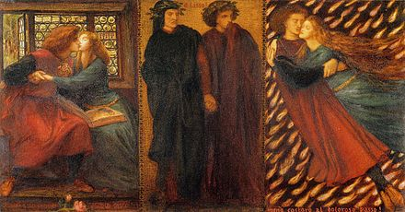
Critical Viewing
P. 681 Similar to Dante, the artist shares sympathy for Paolo and Francesca. In the illustration, the artist portrays both Dante and Virgil in a depressing manner to represent their sympathy for the couple. Although Francesca and Paolo are punished to a life in hell, the artist still illustrates them close together to show his compassion for the tortured couple.

Slide 9
Review Questions
Pg.691 #6
At key transitional points in the story, Dante, the speaker of the poem, loses consciousness. In what ways does this solve literary problems for Dante the poet?

