Slide 1
Incan Art

Slide 3
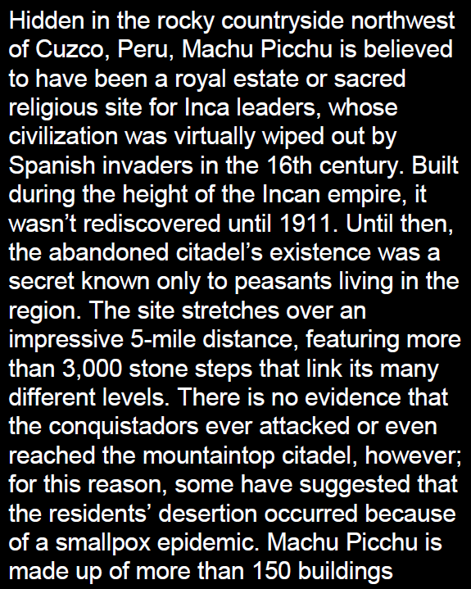

Slide 10
