Slide 2
1945: Women in Japan get the right to vote
1950-1952: The class of large land owners/landlords in China was disposed of
1963: China began to practice the state family planning process
1963: Japan began to advertise having more respect and love for elders
1960's: Many Chinese women join the communist movement for more gender equality
1970's: China revised its nation-wide family planning program
1970's: Chinese women began to move away from their traditional domestic duties
1980's: China came out with the current day family planning program

Slide 3
1948: People's Democratic Republic of Korea:
1949: Communist victory in China which established the People's Republic:
1950-1951: Purge of the landlord class in China.
1958: Great Leap Forward.
1973: Gang of Four- Jiang Qing, Hang Hongwen, Yao Wenyuan, and Zhang Chunqiao.

Slide 4
During the economic boom in the 50's and 60's, China and Japan began modernizing their cities. Some of the most innovative buildings were built around this time.
During the Mass migration of Koreans during the civil war, thousands died due to starvation and hypothermia.
Due to the massive renovation of major cities. Urban populations began to grow. Even in China where 75% of the population was part of the agricultural work force.

Slide 5
Japan:
New liberties were guaranteed, along with gender equality and bargaining rights
Japan no longer had a claim to Shinto Divinity
Developed one of the most meritocratic systems in the world, where people are based on ability and talent.
Shame was directed toward nonconformist behaviors
They persevered important traditional elements shown through their films and novels
Japanese painters and architects participated in the "international style"

Slide 6
The Rest of the Pacific Rim:
Stressed group loyalties against excessive individualism or protest and in support of hard work
Confucian morality was a big part of their culture
Vietnam and China
After the Vietnamese War, China and Vietnam embarked new scale revolutions that would clear away the rubble of the failed Confucian system

Slide 7
Japan:
With US occupation: Labor unions and savings were encouraged, restricted imports; Korean war = Japanese economic boom
Government supported "social market"
Economic reforms- breaking up large pieces of land and giving it to mall individual farmers (ended feudalism in many areas); Zaibatsu’s (conglomerates) were dissolved temporarily
50s: coal & steel industry and exports
'60s-'70s: consumer goods and automobiles
'70s on: knowledge based products (electronics)
Organized company unions did not get in the way of the company’s productivity; also provided a life time of employment -> low average unemployment rates, workers reluctant to take vacations.
labor system: both less class-conscious and less individualistic than labor forces in more industrialized western nations.

Slide 8
Korea: ​
South Korea- Mixed economy
Large support from USA and outward-looking strategy (early 60s)
large industrial firms created and resulted in cheap consumer goods, steel, automobiles and textiles. ​
Export led industrialization
North Korea-
privately owned farms
State owned enterprises (iron, steel, chemicals, textiles and machinery)
After Korean war, tried to mobilize labor force and natural resources to achieve rapid economic development with aid from other communist countries
Vietnam:
Tried to maintain a highly centralized command economy -> stifled economic growth
Pressure to expand and liberalize the market, opening to foreign corporations.
Sweat shop conditions in foreign factories.

Slide 9
China:
Communist economic reform programs:
5 year plans (begun in '53) - 12 completed
Rapid industrialization = successful development
Rural to urban
During the Great Leap Forward ('58-'60):
Producing goods for more industrialization (cement, tractors)
Peasant communes regulated by commune leaders and heads of local labor brigades
Economic disaster: Peasant resistance to collectivization, abuse of commune leaders, low output from factories.
Major drought as well as population boom resulted in famine as the agricultural economy could not keep up.
Under Deng Xiaoping, farming communes discontinued and private production was encouraged.

Slide 10
Taiwan and city states:
Taiwan-
Productivity in agriculture and industry increased rapidly.
Japan is single most important trading partner
Singapore-
Economic success based on a combination of government controls and initiatives and free enterprise.
World's 4th largest port.
Manufacturing (electronics, textiles, and oil refining) and banking more dominant than shipping.
1980's=second highest per capita income in Asia
Hongkong-
Major world port; export production combines high-speed tech with low waged workers working long hours

Slide 11
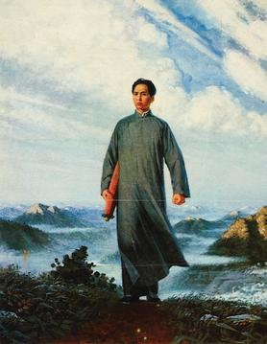
artist unknown, based on an oil painting by Liu Chunhua, c. 1969 C.E, color lithograph
considered “art for the people” after Mao Zhedong came to power, to convey communist ideas in accessible ways
realistic oil paintings of the commonfolk were starting to replace the popular ink paintings of landscapes and birds and flowers around the time of the initial painting
depicts the Chairman young, and walking towards the coal mine
Mao was in a group of enthusiastic communist leaders who guided mineworkers into a successful strike
uses a heroic pose and warm glowy tones as the ideal coloring
became one of the most popular images of the Cultural Revolution

Slide 12
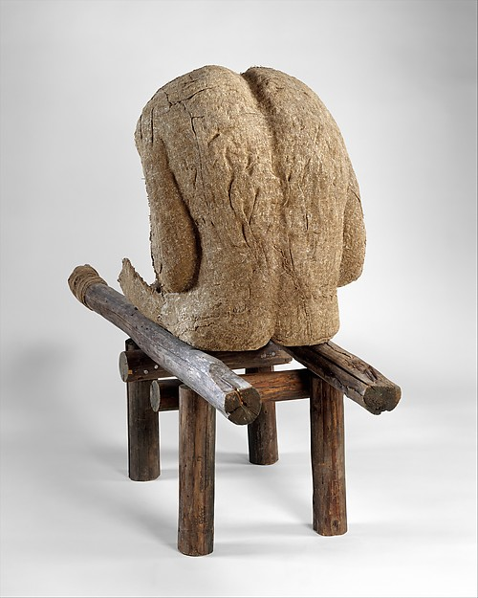
Magdalena Abakanowicz, 1985 C.E. Burlap, resin, wood, nails, string
the polish artist is known for her fragmented human figure-faces without skulls bodies or heads and torsos without legs
hardened fiber surface assumed organic characteristics like the cellular composition of human skin
uses the same molded torso shell that the artist used in her back series
“the face can lie, the back cannot” is what the artist says when asked about her fascinated with the human back
through these provocative images, the artist expresses the physical and spiritual condition of mankind
artist says nothing is literal and is all metaphoric

Slide 13
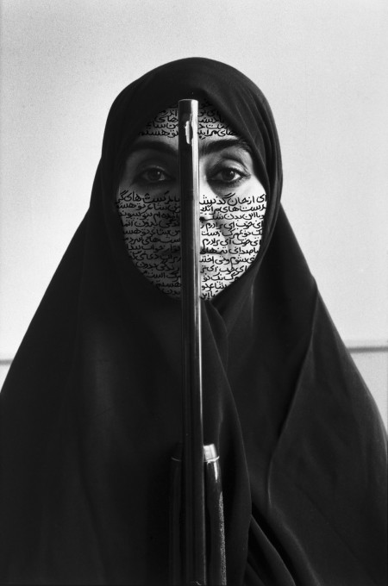
from the women of allah series, Shirin Neshat (artist), photo by Cynthia Preston, 1994 C.E, ink on photograph
the artist is from the united states, but the artwork reflects the Islamic society, primarily
in this art piece she questions the position of women in Islamic culture in the fight between tradition and revolution
this image, is a women holding a gun, her face covered in writing, getting ready to go to war
the images in the series are portraits of women that are overlayed with Persian calligraphy

