Slide 1
Chapter 32 (Latin America: Revolution and Reaction in the 20th century)
Lauren Whitman, Isabella Maxwell, Kelsey Foster, Ian Morceau, Eric French, Grace Gardner, & Reggie Johnson

Slide 2
Social
During the 21st century there was an increase of population in the Latin American Countries,
Social criticism produced powerful realist novels
Revealed the exploitation of the poor
Social classes were based on economic structure, the higher classes tended to be the wealthier classes
Soon, government programs were formed to help supply laborers
Discrimination on basis of ethnicity continues
To be called Indian is considered an insult in many places
Relationship with Indian population is filled with exploitation and discrimination
Occurs in nations as diverse as Brazil, Nicaragua, and Guatemala

Slide 3
Women- Social
Women worked under inequalities in the workplace and in politics and denied the right to vote anywhere
Ecuador first to give women right to vote in 1929
Brazil and Cuba follow in 1932, and Argentina in 1945
Women were associated with religion and the Catholic church which made reformers fear women would be a conservative force in politics
In response women began to form various clubs to push for the vote and other issues to interest them
Many feminist organizations and suffrage movements began to form
This combined with international pressures eventually brings change
Even after gaining the vote women had little influence in politics due to prejudice

Slide 4
Women- Social
Women made up ~80 percent of textile and clothing industry in Argentina in 1911 and worked under unfair conditions
Many joined the anarchist, socialist, and other labor unions/ organizations
In some countries women working in markets had control over much small-scale commerce
By mid-1990s position of women in Latin America was closer to that in western Europe and North America than to other areas of world
Women made up 9% of legislators in Latin America, which was higher than any other region in the world
Position of women reinforced Latin America’s position between industrialized and developing nations

Slide 5
Political (1930-2000)
Towards the end of the first world war and the beginning of the great depression Latin America struggled through a series of political leaders, wars, and issues between the communist Soviet Union and the capitalistic United States.
After world War 2, the US and numerous American leaders (President Roosevelt, kennedy, Reagan, Bush, etc) took interest in maintaining security and fixing the problems that plagued Latin America.
During the early to middle half of the 20th century there was a dramatic increase in radical reform and revolution throughout Latin America.
In the second half of the 20th century while the world was struggling through the cold war between The United States and The Soviet Union, many of the Latin American countries were converting from communism to new democratic ideals.

Slide 6
Political leaders of Latin America (1930-2000)
At the end of the Great Depression Latin America went through a plethora of political leaders that ruled under democratic, communist or autocratic ideals.
(1946)Juan peron- A leader who ruled in Argentina, and brought about political repression through severe actions. His main accomplishments were bringing new forces like Argentinian workers in the Argentine politics. Ruled with a populist platform. And inspired “peronism” even after his defeat. Peron’s actions in politics would influence future dictators and eventually the term “dirty war”.(Overthrown in 1955)
(1951)In the wake of the second world war Getulio Vargas came into power in Brazil. He brought about a program of populist nationalism
(1944)Guatemalan president Juan Jose Arevalo would rule as president under the idea of spiritual socialism that included land reform and an improvement in rights and conditions of rural and industrial workers. Put guatemala in direct conflict with the “United Fruit Company”.

Slide 7
Political Leaders of Latin America (1930-2000)
(1951) After Juan Jose Arevalo, Colonel Jacobo Arbenz won a free election and brought about a nationalist program that was much more radical than previous presidents. During Arbenz’s rule there was much more US interference in the wake of the communist imperialism that the Soviet Union began imposing throughout the world (imposed economic restrictions and diplomatic restrictions). With the help of the US central Intelligence agency the Arbenz government fell and was replaced by a pro-American regime.
(1934-1944) Fulgencio batista was an authoritarian reformer who grew from the lower ranks of the army into a leader of Cuba. batista's programs were marred by corruption and by 1952 he was a full on dictator.
(1953)Fidel Castro was a revolutionary who sought to return the government to a democracy with social justice and the idea of a less dependant economy. An attempt for him to be overthrown was issued in the Bay of Pigs by John F. Kennedy(Failure).
Augusto Sandino was a Nicaraguan resistance leader who became a figurehead of the Sandinista party after his assassination by US trained troops.
Salvador Allende-a Chilean physician and politician, known as the first Marxist to become president of a Latin American country through open elections.
Augusto Pinochet- New ruler put in place after government collapses on September 11, 1973.

Slide 8
Political key events/definitions(1930-2000)
1937, president Roosevelt introduces the “ good neighbor policy”- to stop direct interventions
US program “alliances for progress”- develop the regions as an alternate to the radical political situations
President Jimmy Carter created an initiative to deal with Latin America problems and to influence the regional government to switch to civil liberties.
Ronald Reagan and George H. Bush issued direct intervention (ex. Toppling an autocracy in Panama).
Zapatistas- (1910)revolutionary armed guerilla group(Emiliano Zapato). Handled with oppression and negotiation
(1945)-15 bills were introduced for women's suffrage movement-still did not guarantee political rights.
(July 26, 1953)- Fidel Castro leads an unsuccessful attack on the government.
(1954)- US Centralized Intelligence Agency organized and invades guatemala in order to stop the spread of communism.
(1960s)-Military forces in Cuba began overpowering government officials in order to lead the country.
(1961)- US launches an unsuccessful attack on Cuba after learning of nuclear missiles being placed on the coast of Cuba.(issued by John F. Kennedy).

Slide 9
-Mexico issues a new one-party-system that promotes stability.
(Summer of 1973)-political storm throughout Latin America. Later leads to radical, revolutionary change.
September 11, 1973- government of Chile(Salvador Allende) overthrown.
-Dirty war- During the destruction of the Chilean Government (3,000 killed or disappeared, 80,000 arrested, 200,000 in exile, knowns as dirty war)
1982- Argentina goes to war with Britain(Falklands War)-wants growth and nationalism, eventually lead to to confrontation over the falkland islands with Britain. Caused a loss of the military's credibility
1983-elections restored democratic involvement in the government.
(1985-1989)-Brazil returns to democracy and chose 1st popularly elected president
-(1990)- democratic ideals enforced in Latin America
-(1990s)- North American Free Trade Agreement- lead to a friendship between Mexico and The US.
(1992)- civilian government returns in El Salvador.
(1996)-Civilian Government returned to Guatemala
-These events of democratic ideals and a US embargo lead to the Sandinista party being removed from the Nicaraguan elections of 1990
(2000)- PRI ended and eventually replaced with National Action Party by Vincent Fox

Slide 10
Interaction
Migration in Latin America
Industrialization in Latin America lead to emigration and massive urban growth in many places
A growing urban middle class linked to commerce, industry, and expanding state bureaucracies began to play a role in political process
The cause for this change was declining mortality and high fertility
Immigration to Latin America
Was fed by flow of workers seeking jobs, the demands of capital for cheap labor, and the flight of political refugees seeking basic freedoms
Movements of workers from poorer countries to the stronger economies
Industrialization in 20th century depended on highly mechanized industry that did not create enough new jobs to meet the needs of the growing population
Most of immigration was to United States, but also movement across Latin American borders
Haitians migrate to work in the Dominican Republic and Columbians illegally migrate to Venezuela

Slide 11
Interaction
Politics also motivated migration
Haitians fleeing political repression and awful conditions had risked dangers in small open boats to reach United States
Cuban Revolution caused one of the greatest political migrations of the century
Began in 1959 when the Cuban middle class fled socialism, and continuing into the 1980s with the flight of Cuban workers
Revolutionary upheaval in Nicaragua, political violence in Central America, and poverty in Haiti contributed to refugee migration
Intranational migration (within country)
Movement from rural areas to urban areas in Latin America during the 20th century
Latin America went from agrarian region in 19th century to one-half of population living in cities of 20,000+ by 1980s
Latin America was the most urbanized area of developing world and only slightly less urbanized than Western Europe

Slide 12
Interaction
Rate of growth
Urban populations grew at a rate about three times that of the population as a whole
Urban economies had not been able to create enough jobs for the rapidly increasing population
Recent migrants often lived in marginal neighborhoods or in shantytowns (also called favelas) which have become characteristic of the rapidly growing cities of Latin America
In comparison to Europe
Despite Latin America’s increase in urbanization, its percentage of population in urban areas is still less than in Western Europe but more than in Asia and Africa
Those who succeeded in securing industrial jobs often join oppressive labor organizations that are linked to the government
Separation between the underemployed urban lower class and the industrial labor force
Where industrialization and urbanization promoted a strong class unity in 19th century Europe, in Latin America nationalist and populist politics had weakened the ability of the working class to operate effectively in politics

Slide 13
Culture
Popular culture is influenced by African and Indian craft, images and techniques, but arranges them in new ways.
Hispanic traditions (family, gender relations, business, and social interaction) are still influential.
Helped determine response to modern world.
Religion
From 1900-60, the mass majority (~90% of total population) of Latin Americans were Catholic.
From 1960-present, the Protestant Church has been making inroads. (~19% Protestant and ~69% Catholic).
In 1922, Brazilian artists, composers, and authors held a Modern Art Week to emphasize a search for national artistic expression.
Showed search for national artistic expression that reflected reality in Brazil

Slide 14
Culture
Music
Argentine tango began in music halls of lower-class working districts of Buenos Aires and spreads to entire nation.
Brazilian samba and Caribbean salsa also spread widely
Literature
Poets and novelists used magical realism and gained worldwide recognition.
Realist novelists, such as Miguel Angel Asturias, wrote about the corrupt and evil dictator that will doom his people.
Some of his other novels talked about the evil and corruption of his and other countries.
Social and political criticism is still important and influenced development of newer art forms such as film

Slide 15
Economic
Economic changes in Latin America
Income gap actually got worse, property issues don’t change, gains in literacy and health, and industrialization possible
Latin America began gaining closer ties with growing international capitalist economy
Become vulnerable to changes in world financial system and dependent on markets, financial situation, and economic decisions made by others
Challenges of economic growth were of both internal and external origin
Ranged from steady population increase for the region as a whole to the consequences of Latin America’s ever-closer incorporation into the world economy
Economic growth started in 1960 with agreements fostering economic union
Latin American Free Trade Association
Andean Pact of 1969

Slide 16
Economic
Some progress was made toward regional economic integration, but the commitment to eliminate trade barriers was not as strong as in postwar Europe
Latin America's major mineral resources are gold, silver, copper,iron ore, tin, and petroleum.
Emphasis on agricultural and mineral production grew in some places.
Cuban economy dependent on world market for sugar.
Guatemala faced some of the region’s worst problems, including illiteracy, poor health, and high mortality.
Its economy depended almost exclusively on banana and coffee plantations.
Like the Asians and Africans, the Latin Americans had been suppliers of foods and raw materials to the rest of the world.
The Great Depression posed a great challenge to the region.
The collapse of the world economy meant that the demand for raw materials drastically declined, hurting many of the economies in Latin America.

Slide 17
Art

Slide 18
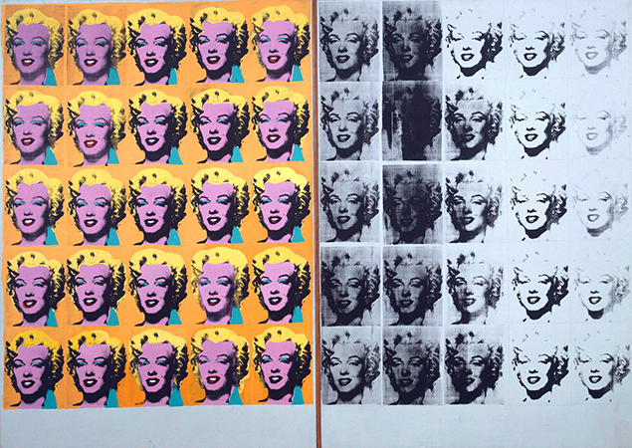
Marilyn Diptych. Andy Warhol. 1962 C.E. Oil, acrylic, and silkscreen enamel on canvas
This image is made of two silver canvases on which the artist silkscreen a photograph of Marilyn Monroe fifty times each a slightly different shade. This is split into two one black and white the other with bright colors
This art piece is the start of pop art and an expressionist piece. His new take on art showed common material, like a soup can, and makes them unnatural with bright colors. This change of color challenges the traditions of using natural colors and making art realistic.

Slide 19
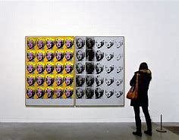
Marilyn Diptych. Andy Warhol. 1962 C.E. Oil, acrylic, and silkscreen enamel on canvas
The repetition makes her face look less glamorous and makes it seem life less, almost like a mask.
With this piece Warhol is introducing the prototype of pop art to the world, in a way that celebrates women. This suggest that he was big into views such as women’s rights as well as someone who wanted to show others a new type of art unlike anyone had seen before.
This relates to the chapter through the biggest social change that occurred in it- rise of feminism. Women in Latin America are just beginning to gain rights such as voting and Warhol’s piece celebrates women with bright, bold colors and a style that catches your eye

Slide 20
The Bay. Helen Frankenthaler. 1963 C.E. Acrylics on canvas.
This painting presents a fluid blue splotch that gradually changes from violet to indigo back to violet and then to indigo again. This splotch is almost hovering above the Earth. Underneath, it shows a mossy green. The blue splotch is the bay with the green being the earth underneath. At the top of the painting is an off-white sky. The sky is a stark contrast to the many shades of blue. The contrast is signifying the change from bay to sky.

Slide 21
The Bay. Helen Frankenthaler. 1963 C.E. Acrylics on canvas
Frankenthaler was considered an abstract expressionist because her art made you think about its shape and meaning while using unconventional methods of doing so. She used the “soak stain” technique, which included turpentine-thinned paint onto canvas, making bright color washes that seem to merge with the canvas. This gives the piece a flat 2-d look.
Frankenthaler was a female artist, which was gradually becoming less unusual but was it was still likely she felt discriminated. She created a painting that was so different from most others at the time and that was completely open-ended and left for the viewer to decide what it meant. This was likely because she knew that if she wanted to be recognized and leave her mark then she had to stay true to herself and her vision by creating something both unusual and unique.
This relates to the chapter in that Latin America at that time was going through a series of revolutions that got rid of imperialism and made Latin America self-governing. This was new and frightening and caused many people to be unsure how it would all turn out, which is conveyed in the painting through the unsure, open-ended shapes that are left for interpretation

Slide 22
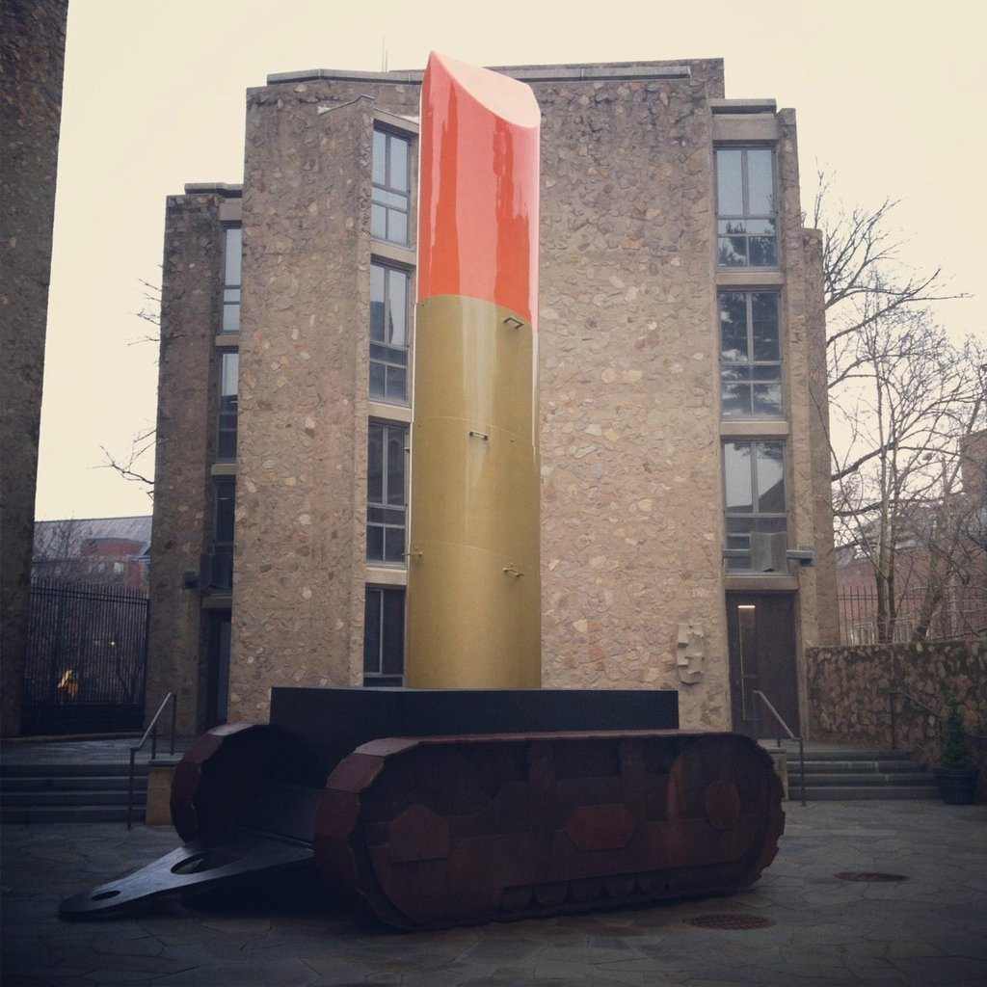
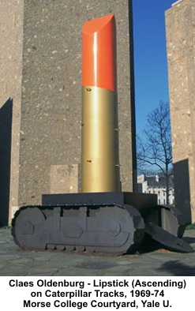
Lipstick (Ascending) on Caterpillar Tracks. Claes Oldenburg. 1969-1974 CE. Cor-Ten steel, aluminum, and cast resin: painted with polyurethane enamel.
Base of this sculpture is a military tank and a feminine product, lipstick, is ascending form it. The tube of lipstick is 24 feet high and looked over the office of the Yale’s president as well as the World War I memorial.
Intended as a platform for anti-war protests from students.
Caterpillar tracks- what the tracks on the tanks are called

Slide 23
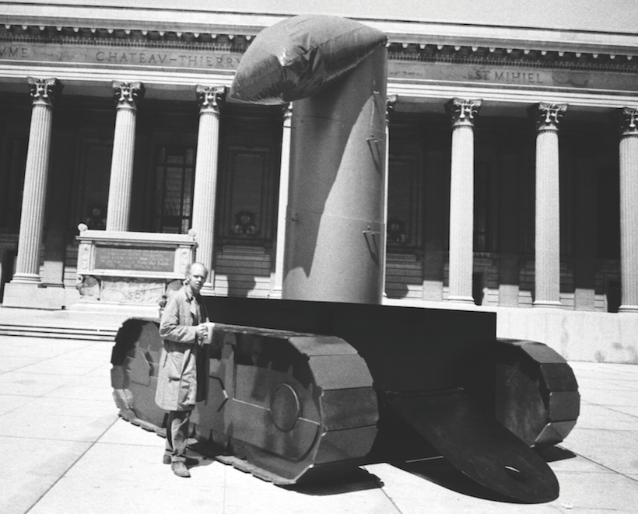
Lipstick (Ascending) on Caterpillar Tracks. Claes Oldenburg. 1969-1974 CE. Cor-Ten steel, aluminum, and cast resin: painted with polyurethane enamel.
Sculpture was not meant to be permanent. Oldenburg originally made the sculpture with a base of plywood and
implied that the U.S. obsession with beauty and consumption both fueled and distracted from the ongoing violence in Vietnam.
Oldenburg brought both domestic and military objects into a public space, this blurred the lines between public and private, as well as brought questioning to political standpoints as well as culture in the United States. In doing so, it upheld Oldenburg’s 1961 declaration that “I am for an art that is political-erotical-mystical, that does something other than sit on its butt in a museum […] I am for an art that imitates the human, that is comic, if necessary, or violent, or whatever is necessary […].”

Slide 24
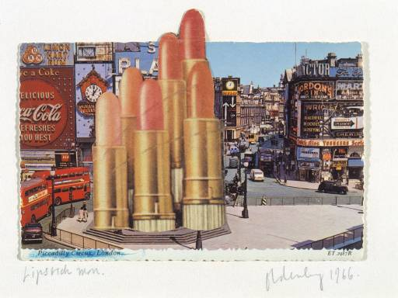
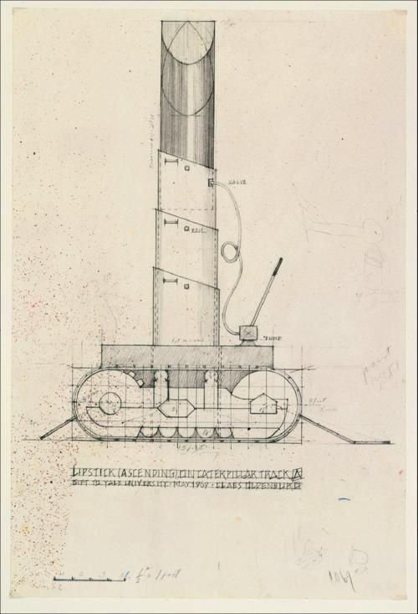
Lipstick (Ascending) on Caterpillar Tracks. Claes Oldenburg. 1969-1974 CE. Cor-Ten steel, aluminum, and cast resin: painted with polyurethane enamel.
Implied that the U.S. obsession with beauty and consumption both fueled and distracted from the ongoing violence in Vietnam.
Oldenburg had experimented with lipstick art before and would cut out magazines and paste the tubes into cities to look like pillars.
This relates to Chapter 32 by advocating feminism, a main topic throughout the chapter. By pairing a feminine product with a heavy piece of male machinery, it views the two gender roles more as equals.

Slide 25
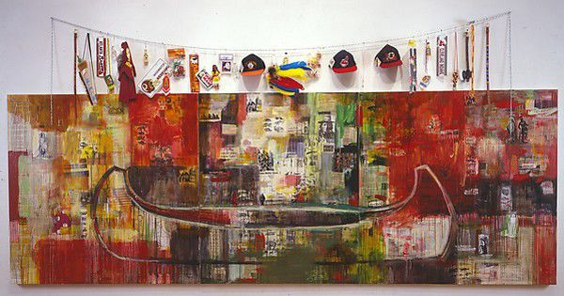
Trade (Gifts for Trading Land with White People). Jaune Quick-to-See Smith. 1992 Ce. Oil on paint, and mixed media, collage, objects, canvas.
Triptych- three part arrangement/ three panels
Smith covered the canvas in collage, with newspaper articles about Native life cut out from her tribal paper, photos, comics, tobacco and gum wrappers, fruit carton labels, ads, and pages from comic books, all of which feature stereotypical images of Native Americans. She mixed the collaged text with photos of deer, buffalo, and Native men in historic dress holding pipes with feathers in their hair.
Canoe suggests the possibility of trade and cultural connection since the Canoe is used by people across the globe to trade in early centuries.
The color red had several meanings tied to native heritage and other meanings such as blood, warfare, anger, and sacrifice.

Slide 26
Trade (Gifts for Trading Land with White People). Jaune Quick-to-See Smith. 1992 Ce. Oil on paint, and mixed media, collage, objects, canvas.
Brushstrokes were very vivid and prominent and related back to abstract expressionism. The brushstrokes brought in deep emotional emphasis as well as a look at social chaos.
This art piece was a response to the 500th anniversary of Christopher Columbus ‘discovering’ North America.
Trade references the role of trade goods in allegorical stories like the acquisition of the island of Manhattan by Dutch colonists in 1626 from unnamed Native Americans in exchange for goods worth 60 guilders or $24.00.
The layered images, articles, and objects in the collage possibly suggest layers of history and complexity.
This relates to Chapter 32 with its representation of the economy at the time. With decolonization came a boost to the economy, causing trade to increase as well. The painting shows this through its use of many collage materials that came from different goods Latin America was exporting at the time.

Slide 27
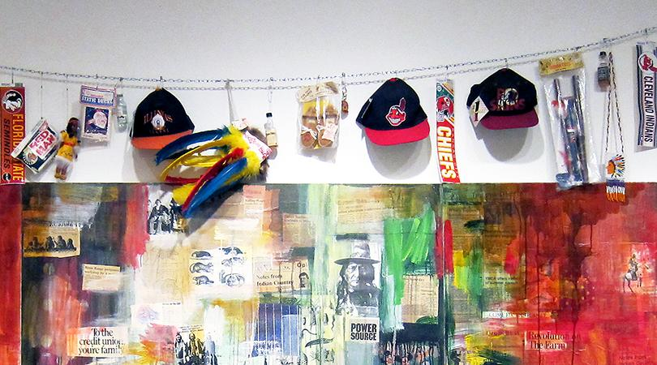
Trade (Gifts for Trading Land with White People). Jaune Quick-to-See Smith. 1992 Ce. Oil on paint, and mixed media, collage, objects, canvas.
“Above the canvas, Smith strung a clothesline from which she dangled a variety of Native-themed toys and souvenirs, especially from sports teams with Native American mascots. The items include toy tomahawks, a child’s headdress with brightly dyed feathers, Red Man chewing tobacco, a Washington Redskins cap and license plate, a Florida State Seminoles bumper sticker, a Cleveland Indian pennant and cap, an Atlanta Braves license plate, a beaded belt, a toy quiver with an arrow, and a plastic Indian doll. Smith offers these cheap goods in exchange for the lands that were lost, reversing the historic sale of land for trinkets. These items also serve as reminders of how Native life has been commodified, turning Native cultural objects into cheap items sold without a true understanding of what the original meanings were.”

