Slide 1
Ch. 31 Presentation:
The SPICE of Life
1945-2001
By: Alyx Kinsey, Abdulla Warrayat, Emma Bookout, Jordan Jones, Coal Glasgow, Mitchell Gilbert

Slide 2
Social (West Europe and U.S.)
The U.S. formed NATO along with the other north American countries to protect against Soviet influence in trade.
Technocrat class created - aristocrats who were highly trained in engineering or economics.
The Great Civil Rights movement lead by MLK Jr. In the U.S. in 1963- more than 250000 people.
Workers were still property-less.
WWII women's rights movements throughout Europe and the U.S.
Social strata switched to compensate for more working middle class.

Slide 3
Social (East Europe and Soviet Union)
Soviets made the Warsaw Pact.
Solidarity movement - Independent labour movement in Poland.
Eastern social structures gradually became more like the west despite the Marxist influence.
Despite the great skill of eastern women, they were still valued less than their western counterparts - A trend that will continue to this day.
Nikita Khrushchev - Beaurocrat who openly attacked the Stalinism sociopolitical implications.

Slide 4
Political
United states & western Europe
Cold war, heightened tensions between the United States and Soviet Union
During the cold war the united states and USSr both wanted to prove technological advances with the space race
Oil crisis caused great unrest in the U.S.
The Korean and Vietnam
Europe and the Marshall plan
The divide of Berlin

Slide 5
Political
Soviet union and Eastern Europe
The Soviet union take over of nearly all of Eastern Europe was known as the soviet bloc
Hungarian revolt a student led protest
Brief freedom known as prague spring in czechoslovakia

Slide 6
Political
Soviet Union and Eastern Europe
Gorbachev final leader of the Soviet union before it fell in 1991
Iron curtain separated the eastern part and western part of europe
Soviet union invaded Afghanistan

Slide 7
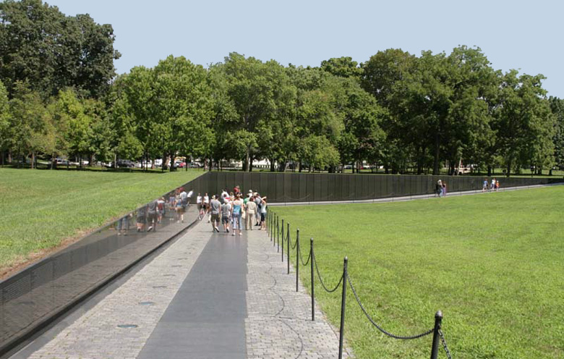
Vietnam Veterans Memorial. Washington DC, U.S. Maya Lin. 1982. Granite.
Located between The Washington Monument and The Lincoln Memorial
Located specifically here to “unite to nations past”
Series of 10 ft high granite walls engraved with over 58,000 names
Black granite for reflection and peaceful feel
Mirror would double the size - two worlds; a world we are apart of and one we can’t enter
Lin made sure not to pick granite from Canada and Sweden(countries with the best granite) because of political backlash, draft dodgers went to Sweden and Canada

Slide 8
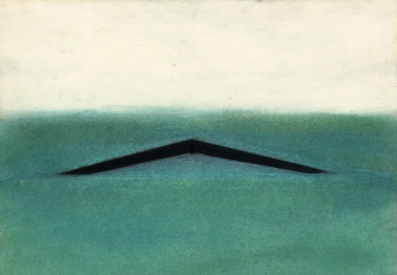
Lin had the impulse to cut into the Earth; as you walk in you walk down
Lin felt that the memorial would help people come to terms with the death of loved ones and the memorial is apolitical
Starting at the center are the names of people that died in 1959 and then going down toward the right continues the name in later years

Slide 9
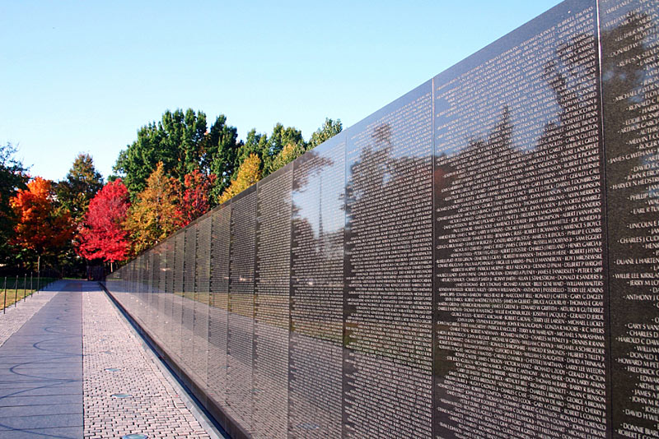
Lin believed that a name means more to a family then a picture
A picture is a point in time
Names tell all about the person
Different from most war memorials because others had the general or military hero showing allegory or heroism, all absent here
Maya Lin is an Asian American - rose controversy and racism
People didn't like how abstract the piece was so Lin put up a memorial adjacent from the memorial, of soldiers the piece is naturalistic and less intimate

Slide 10
Interaction (West Europe and U.S.)
Consolidation of many democracies formed decent welfare states.
Green movement in several countries in the 70’s in response to uncontrolled economic growth.
1950-60’s - French, German, and Italian populations grew by around 6-10% a year.
Massive immigration from poorer areas to more developed areas like the U.S. and U.K.
1940’s - The standard crime rate in Europe increased drastically.
Demographics shrift to allowing women to hold better jobs due to effects of world wars.

Slide 11
Interaction (Eastern Europe and Soviet Union)
Soviet Empire expands and pushes sphere of influence into western and eastern Europe.
Immigration out of the Soviet East Germany, but the Berlin Wall was but to stop that.
Massive industrial damage caused by industrialization.
Communist systems failed to solve the problems of agricultural effects on eastern demographics.
Crude death and birth rates began to resemble the west’s as a result of parents caring more about education.

Slide 12
Culture - United States
The Harlem Renaissance - 1910-1930s
A time of African American culture and arts at its peak. The Harlem Renaissance started in the neighborhood of Harlem New York where a once white area was then overtaken by African Americans. Many of the people were from the south and came during the Great Migration
Known figures of the Harlem Renaissance:
W.E.B. Du Bois
Langston Hughes
Adelaide Hall
Louis Armstrong
Civil Rights Movement/segregation - 1950s-1960s
Boycotts/sit-ins, Jim Crow laws, MLK, Civil Rights Act of 1957
Feminism - a movement for women's rights in the 1960s, inspired by the civil rights movement, striving for job opportunities.

Slide 13
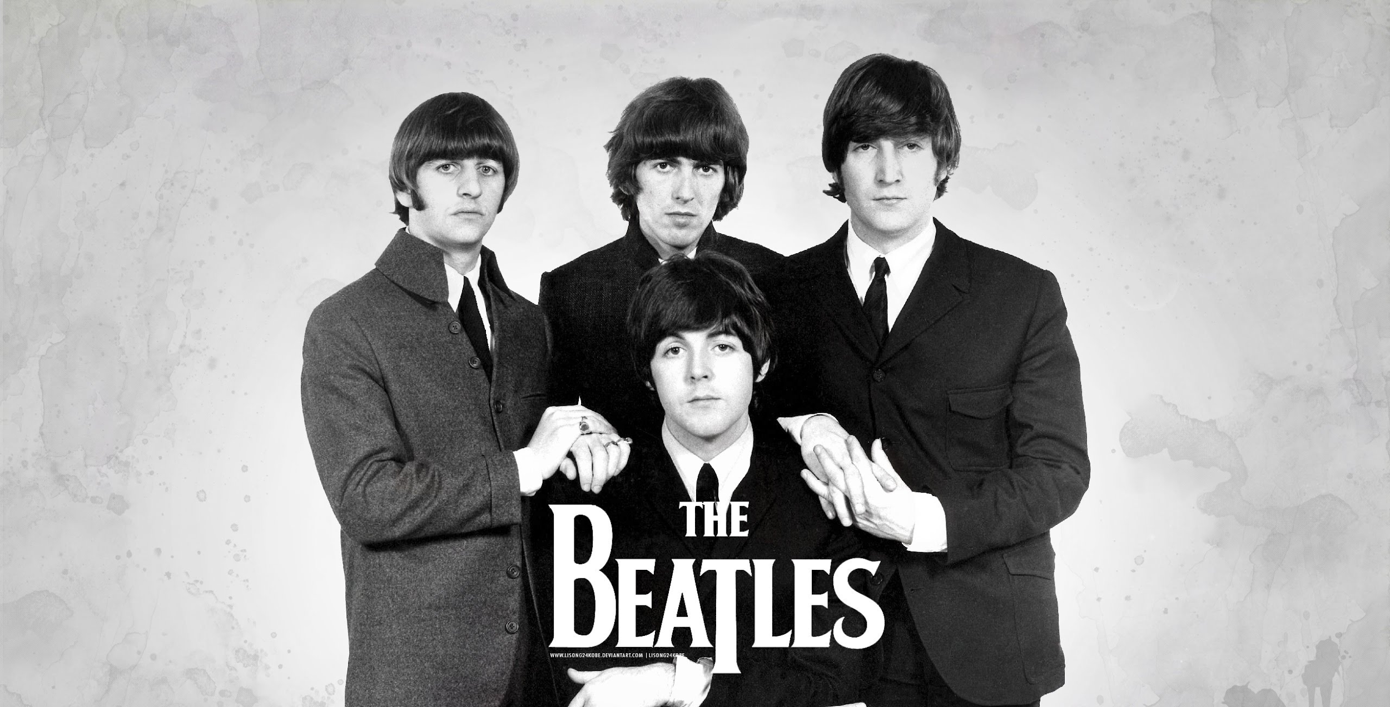
Culture
Western Europe
Women's revolution- employment rate drastically increases as does the the enrollment rate in higher education
Europe’s American habits

Slide 14
Culture- Eastern Europe and Soviet Union
Religions were put under tight government regulations in Soviet Union
Not allowed to give religious instruction to anyone under 18
Most declined in favor of scientific outlook and Marxism explanations
Soviet union attacked modern western styles of art and literature
Socialist realist principles spread to eastern Europe
Soviet and eastern European artists began adopting western styles after 1950s
Jazz, pop, and rock emerging by 1980s
Literature remained diverse, despite official control
Wrote mostly about world war II, and patriotism
Great emphasis on science, social science, physics, chemistry, and mathematics

Slide 15
Economic (West Europe and U.S.)
1947 - The U.S. put the Marshall Plan in affect to help rebuild Europe after the war.
1958 - European Union formed from 6 western countries; Belgium, France, Italy, Luxembourg and, the Netherlands.
After a short rebuilding period the global market explodes.
NATO deflects Soviet pressures on American trade.
Trickle down theory and privatization of the U.S.

Slide 16
Economic (Eastern Europe and Soviet Union)
In the beginning the economy was very strictly based off communistic ideologies, but that shifted as more relaxed leaders came into power in places like Poland.
Trade with the west was greater than ever before.
Backlash from soviet satellites about the economic system imposed.
The east was a strong industrial power between the 1920’s and 50’s.
Eastern women dominated professions such as medicine.

Slide 17
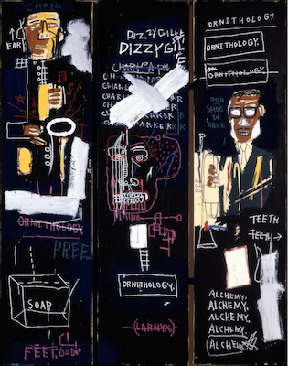
Horn Players. Jean-Micheal Basquiat.1983. Acrylic and oil painting.3 canvas panels.
Triptych - a painted consisting of 3 joined panels
Includes several drawings and words - many then crossed out
Large swaths of white paint - highlights the black backgrounds
Repeated words of: dizzy, ornithology, pree, and teeth
Main subjects: 2 known jazz musicians
Saxophonist - Charlie Parker (left)
Trumpeter - Dizzy Gillespie (right)
Words around him referring to the scat he performed occasionally

Slide 18
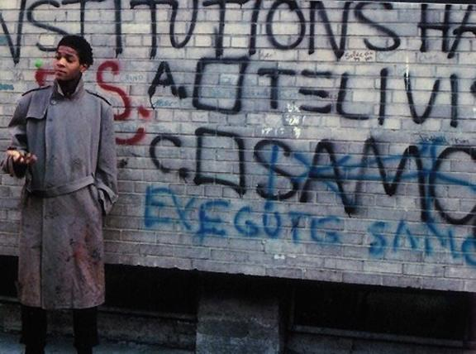
“Ornithology“ is the study of birds, title of famous song of Parkers and is named after his nickname, “bird”
Basquiat is famous for his use of wordplay in his art
Before his success Basquiat would do graffiti in manhattan, usually the subway, and commonly printed “SAMO” (meaning same old shirt) for his identity
The wall writings usually appeared around art galleries and was critical to art

Slide 19
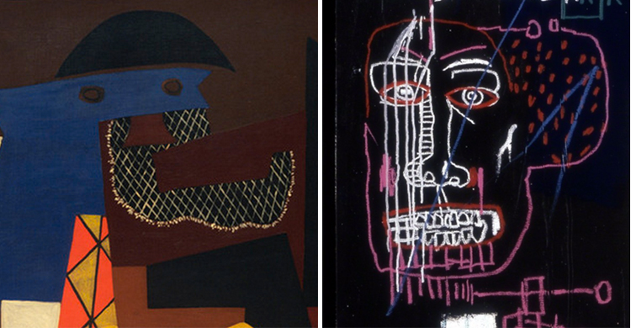
Shed his undercover name and was in many art exhibitions
Times square exhibition and the armoury show
Called the “the Black Picasso”
Similar to Picasso’s “Three Musicians”
Followed the same of the distorted head in the third picture

Slide 20
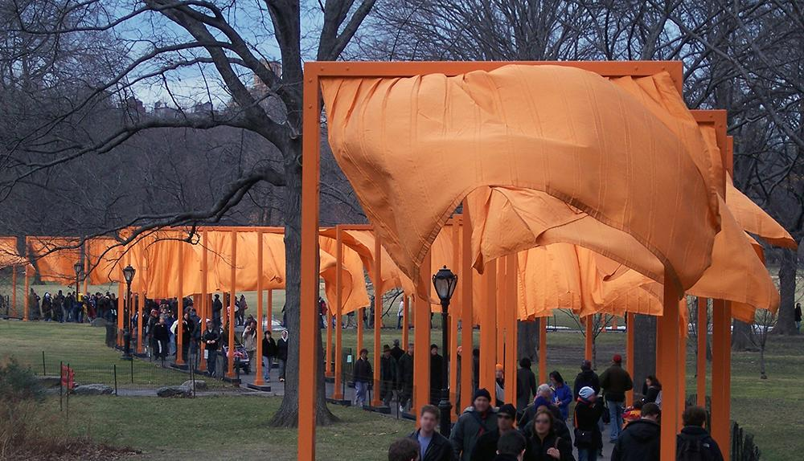
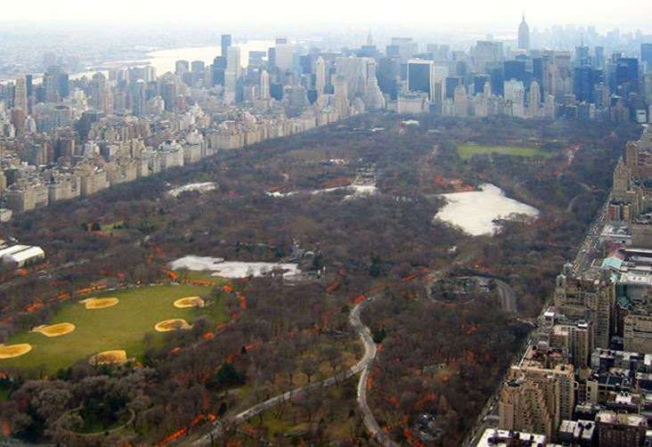
The Gates. New York City, U.S. Christo and Jeanne-Claude. 1979-2005 C.E. mixed media installation.
Pathway of gates throughout central park
Rectangular frames 16 ft tall with saffron colored fabric hanging down like flags
The gates go on 23 miles and there is no set starting or ending place
Controversial in contemporary art
Goal: create a “golden ceiling w/ warm shadows
Most famous example of urban planning

Slide 21
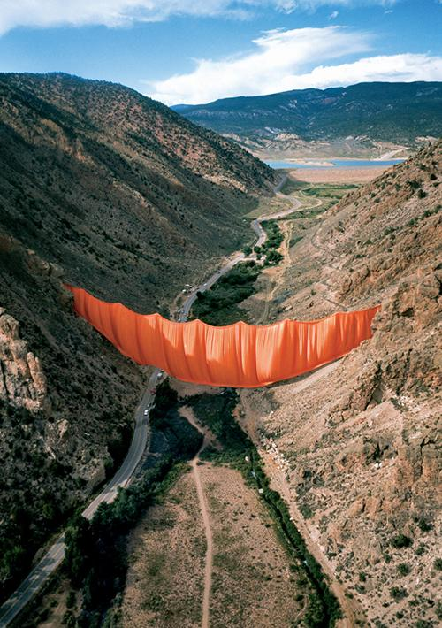
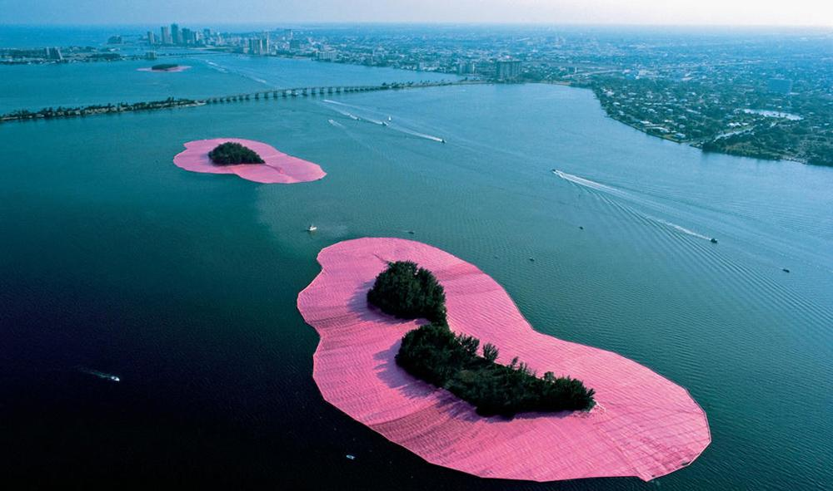
Style of to be looked at in motion not the type to just sit and look at
Went through a long process to get the approval for The Gates; after constant meetings, and proposals, and presentations they got the rights after 26 years!!
Purposely made to not stay forever, temporary art.
Knowing the gates wouldn't stay forever gave people a sense of urgency to go see the piece, they called it an “aesthetic decision”.
Other public art like Valley Curtain in Rifle, CO and Surrounded Islands in Miami, FL.

