Slide 1
African Architecture
Period 3

Slide 2
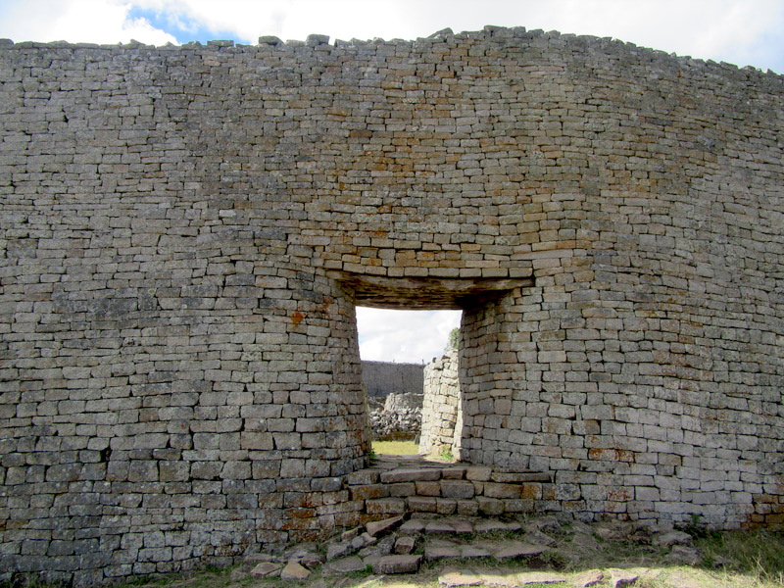
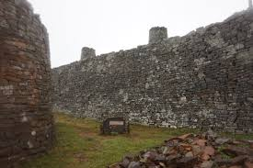
Conical tower and circular wall of Great Zimbabwe. Southeastern Zimbabwe. Shona peoples. c. 1000–1400 C.E. Coursed granite blocks.

Slide 6
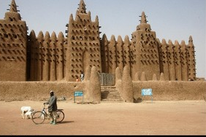
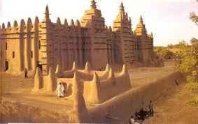
Great Mosque of Djenné. Mali. Founded c. 1200 C.E.; rebuilt 1906–1907. Adobe.

Slide 7
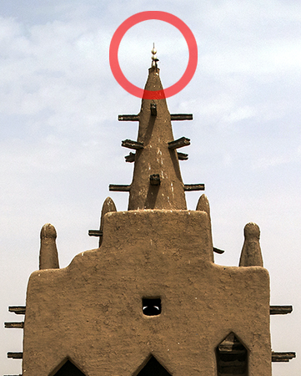
Great Mosque of Djenne, typical mosque complex, is an adobe structure at the heart of the old town of Djenné, Mali.
It still functions today as a mosque with a local congregation.
The first mosque on the site was probably built in the 13th century, following the conversion of the local king to Islam.
That mosque was destroyed by fire in the early 19th century.
It was rebuilt in 1906–1907 C.E. and followed the footprint of the much older mosque.
Significantly, the Great Mosque of Djenné is made of regionally specific materials, such as sun-dried adobe brick.
Timber beams called torons are used both decoratively and as a type of permanent scaffolding to assist in the annual replastering of the building.
The east, or market, side of the mosque is embellished with three towers which are topped by finials of ostrich eggs, a symbol of fertility and purity unique to some West African mosques of the period.

